Slide 1
Design and Technology: Systems and Control Technology (2555)
By Amy Johnson.

Slide 2
Section 1

Slide 3
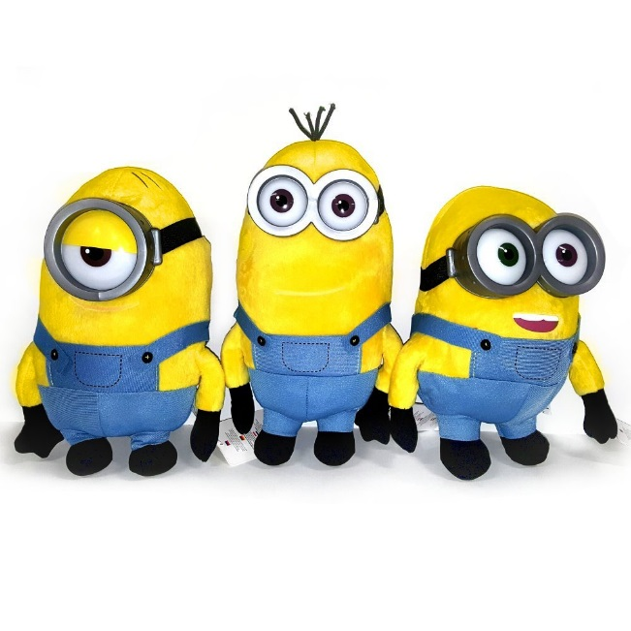
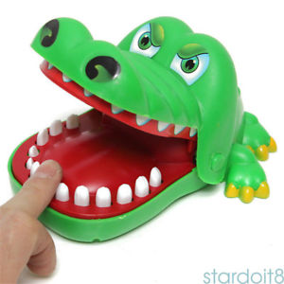
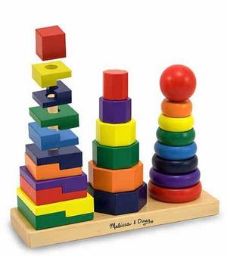
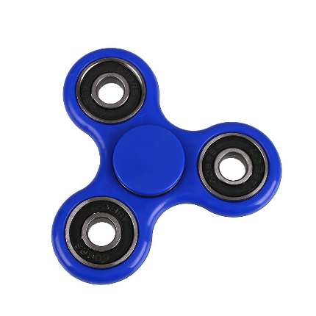
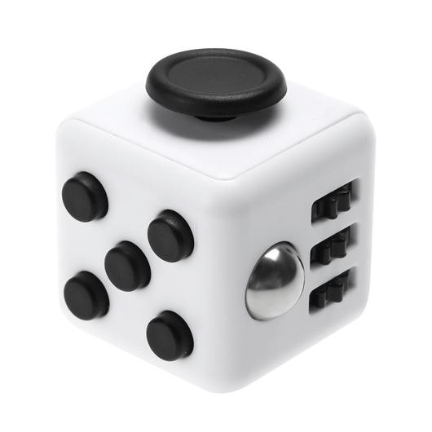
Context and Objectives
Mind map
Children instruments, i.e. a keyboard or recorder
Listening toys
Robotic Toys
Intro
The children’s market at this moment is flawed. For instance the fidget spinner isn’t a toy directed to children/people with ADHD or anxiety disorders like its first intended purpose, it is now a popular toy for everyone (for recreational use) and it is not recognised for the purpose and the help it has done.
I think the children’s market is either too specific for certain criteria or only fit to children who are deemed “fine”.
Children associated objects
Water based toys
Creating pull apart and fix again toys
Electronical platform held games
Visual toys
Educational toys
Visual Toys – I think one of the easiest and most profitable devices you could achieve to make is a visual toy. Something that could be aesthetically pleasing to the eye. It could be a toy that could just contain LEDs and be displayed in a sort of pattern.
Educational Toys – Something thing that could be the most beneficial to society, children specifically. A learning too or something that could enhance a skill.
Aim
The main aim of this project is to make a device/toy that can fit to the needs of a child who has autism, or ADHD, long term fatigue, sleeping disorder, anxiety disorder, bipolar issues, learning disorder, conduct disorder.
Problem
One of the main problems is finding an educational toy that can fit to every child’s needs. Like to a child who is Anaemic, or has ADHD, Anxiety disorder, learning disorder, conduct disorder as well. There’s usually a toy that can fit to one or at least two of those conditions, there should be a toy that can fit a purpose to all of those that I have listed.
Section 1

Slide 4
Context and Objectives
Conclusion –
I will focusing on developing and making this product into an educational toy that can help defeat most symptoms of sleep deprivation, ADHD, anxiety and bipolar disorders and conduct disorders. At the minimum, I would hope to develop this product to at least minimise most symptoms of these.
I will aim to make this product as child friendly as possible, with an aesthetic that will appeal to them and be as ergonomic as possible for parents and child to use. The concept for the product is to be a visual based toy.
To measure the certain specification points that I will develop and assess during the project, I will look at using voltmeters to measure the voltage in the circuits to check on its conductivity. Then I will be using physical measurements such as a tape measure, to check on the physical properties of the product. I will also be using the human eye to check on the main points of what my product should, like if it should rotate or not. Same goes for the other human senses.
Objectives
Design –
Beginning of the project I will be aiming to be developing a toy that could help combat the certain disorders like autism, ADHD, sleeping deprivation and such.
From the beginning I will developing this into a prototype instead of the real product that we would propose to put in the market. This is due to the limitations of the DT lab I am working in. However in later stages of the project I will be looking at the alternatives and what industrial methods and materials that I would use to develop the product that I would put on the market.
As I combat the systems development I will be looking to develop the aesthetics and ergonomics of the product to best fit for a parent and child to use effectively.
I will be aiming to keep this toy as educational as possible, as I would like this product to be as beneficial as it can be.
Manufacturing –
Due to the limitations of the DT lab I am working in, I will aim to develop this product into a prototype rather than a product to put on the market. This is to make sure I can get as much feedback as I can to develop this product further to eventually be put into a market.
I will also aim to looking into manufacturing methods that are industrial as well as I develop the product. This will be concluded in the end of the project.
During the development of the circuitry and the deign aspect of the product, I will be looking into using cheap but extremely effective materials. This is to make the product as cheap as possible to help families buy this product.
Section 1

Slide 5
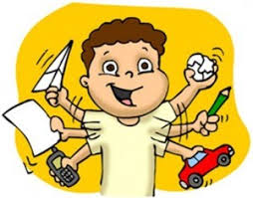
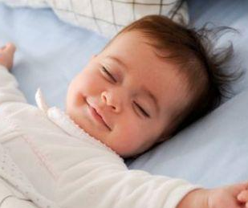
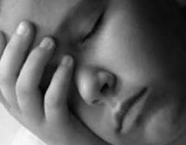




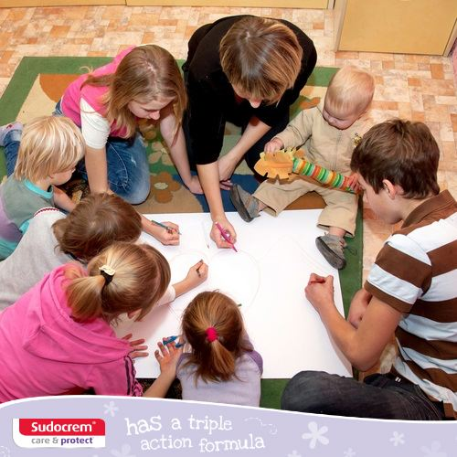

Context and Objectives
Justification
Mood board
https://www.additudemag.com/half-of-all-kids-with-adhd-have-a-learning-disability-or-related-condition/ - The article talks about children with ADHD and or Anaemia. It highly emphasises the difficulties that are faced with children who have such disorders and disabilities. Focuses on the family, behaviour, social skills and emotional problems that come with these issues.
“Fifty percent of children and adolescents with ADHD also have some type of learning disability (LD), such as dyslexia or auditory processing disorder.”
“Fifty percent of those diagnosed with ADHD will have so-called regulatory problems — difficulty regulating their emotions. Some might struggle with anxiety, possibly having panic attacks, while others may experience periods of depression.”
“often caused by frustrations and failures a child has experienced before his or her ADHD was diagnosed. Some kids deal with emotional pain by externalizing their problems.”
http://www6.plymouth.ac.uk/files/extranet/docs/HSW/Conf06_LWiggs.pdf - The research done proves that people with sleeping disorder have a hindrance in their learning abilities. People with ADHD have a 25% to 50% chance of having a sleeping disorder and people who are on the autist spectrum have a 49% to 89% chance of the disorder as well. States in the research that lack of sleep could result in a hindrance to physical growth and a weakened immune system. Also result in a poor reaction time, memory; they won’t be as productive or as effective as they could potentially be in school. There is also the mention of an irritable or more aggressive behaviour, as well as an increase in anxiety and chances of depression and hallucinations. The research conducted has also stats on what families had received help for the problem, only 47% had received effective help (those who had severe learning disabilities (127 recipients) as well as only 54% receiving effective help for those who have autism spectrum disorders (61 recipients).
https://en.wikipedia.org/wiki/Chronic_fatigue_syndrome - The article mainly talks about chronic fatigue syndrome, which the main symptom is long term fatigue. It’s a hinders a person’s ability to be able to carry out any types of tasks. There is no cure at the moment, it also unknown as to what causes this. Symptoms include: muscle pain, sore throats, pain in multiple joints, poor memory and concentration, frequent severe headaches. There is also the fact that people who have chronic fatigue syndrome feel unrefreshed, as if they hadn’t slept, after sleeping.
“About 836,000 to 2.5 million Americans, and 250,000 people in the UK have CFS.”
“A 2003 review reported between 7 and 3,000 cases of CFS for every 100,000 adults.”
“Approximately 250,000 people in the UK are affected with the illness according to the UK Department of Health archives”
Section 1

Slide 6
Section 2

Slide 7
Plan of Action
Time Gantt Chart
 | Sept |  |  |  |  | Oct |  |  |  |  | Nov |  |  |  |  | Dec |  |  |  |  | Jan |  |  |  |  | Feb |  |  |  |  | Mar
Section 1
Section 2
Section 3
Section 4
Section 5
Section 6
Section 2

Slide 8
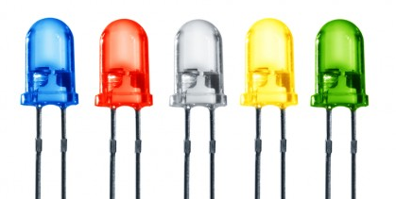
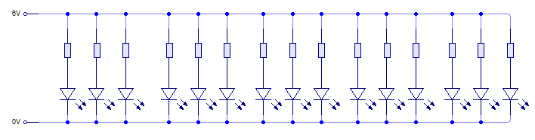
Plan of Action
Investigation into the Problem: What colour LEDs should be used to trigger certain moods?
Why:
I need to enhance certain lights in the room to destress people. The aim of the device is to be able to make children “easier to handle”, to calm them or be able to make them fall asleep.
What am I going to do:
I’m going to display certain lights to various children and survey what colours they liked more and what feelings do they get out of looking at those colours, the rating system will be “happy”, “sad”, “okay”. Research will done prior to make my hypothesis but mainly for the purpose of the device.
Research:
http://www.healthline.com/nutrition/block-blue-light-to-sleep-better#section1
It suggests that reducing the amount of blue light or at least filtering it will help make it easier to sleep. It suggests that having artificial lighting is not appropriate to sleep to, but rather better to wake up to. “Blue light is crucial in the daytime “.
http://timesofindia.indiatimes.com/life-style/health-fitness/de-stress/7-relaxing-colors-and-how-they-affect-your-mood/articleshow/46946305.cms
The source explains that blue is a good colour for destressing and for relaxation, “Peaceful, calm and gentle, blue has tremendous power to manage stress. It's a very soothing color that helps calm your mind, slow down your heart rate, lower your blood pressure and reduce anxiety.” It advises that lighter shades of blue is useful for a calming effect. Light green, light pink, white, violet and pale yellow were colours advised to help reduce anxiety and stress.
https://www.getselfhelp.co.uk/colour.htm
- The source gives a few colours as to what can help reduce certain problems, for example red, orange, gold and yellow help with depression. Blue is good for helping with insomnia, purple is good for inspiration. Pink and magenta help reduce aggression.
http://www.colour-affects.co.uk/psychological-properties-of-colours
- The source gives pros and cons to what each colour gives. For instance; Red increases aggression but gives a lot energy and stimulation. Blue increases intelligence, however reduces socialness. Green increases emotional balance but increases boredom. Grey is able to increase the rate you fall asleep but decrease confidence and increase depression.
Section 2

Slide 9
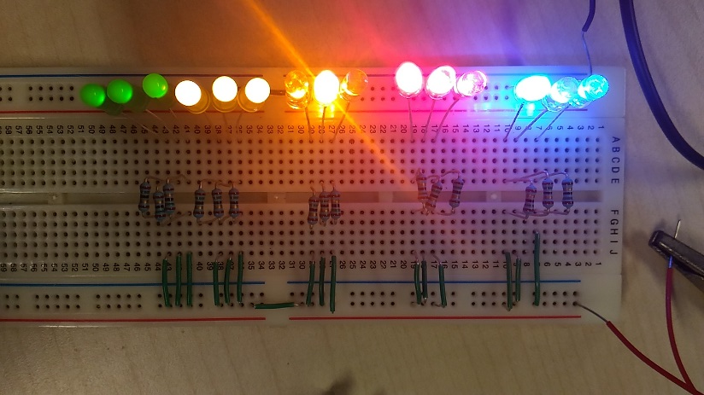
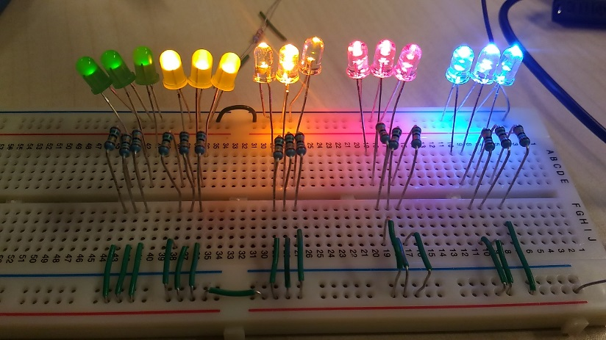
Plan of Action
Investigation into the Problem: What colour LEDs should be used to trigger certain moods?
Hypothesis:
I think most of my peers will enjoy the blue LED as well as the yellow one due to the brightness of the LEDs. Both of the colours do not give off very much brightness but it may mean that to increase the brightness for certain times I will need to have various LEDs than just three or two.
Conclusion:
The colour that got the most positive reviews is yellow, reaching 5 happy comments. However the colours with the least positive reviews is blue and red. I expected to blue to have more positive reviews as this would help calm children but most children want to do a lot so I should have expected the colour not to be liked so much. The results aren’t as black and white as I had hoped but this could potentially help as I could use all the coloured LEDs but vary how much I show each of them and when I do light them up. For instance, yellow would be showed more often, especially in the mornings as this could help children have more energy. Blue could be showed less but could be a big help in making children fall asleep easier.
Results on people’s opinions and moods on the coloured LEDs
 | Participants And their age | 1 (boy aged 5) | 2 (girl aged 4) | 3 (girl aged 6) | 4 (boy aged 4 ) | 5 (girl aged 3) | 6 (boy aged 6) | 7 (boy aged 5) | 8 (girl aged 7) | 9 (girl aged 6)
Colour LEDs | Red | Happy | Sad | Okay | Okay | Happy | Okay | Sad | Sad | Okay
 | Orange | Okay | Okay | Sad | Happy | Okay | Sad | Happy | Okay | Okay
 | Blue | Sad | Okay | Okay | Sad | Sad | Okay | Happy | Happy | Happy
 | Yellow | Okay | Sad | Happy | Happy | Happy | Okay | Okay | Happy | Happy
 | Green | Okay | Happy | Happy | Happy | Okay | Okay | Sad | Okay | Sad
Section 2

Slide 10
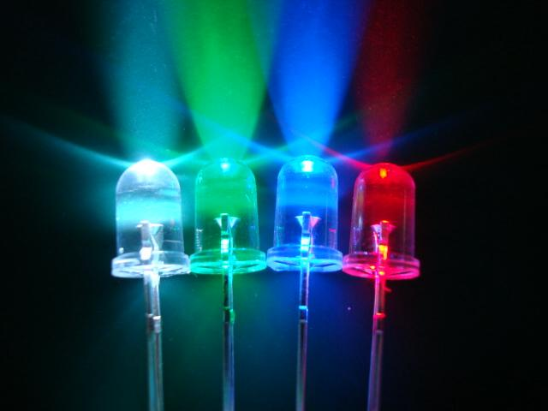
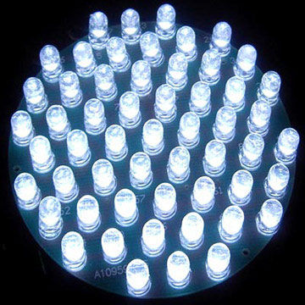
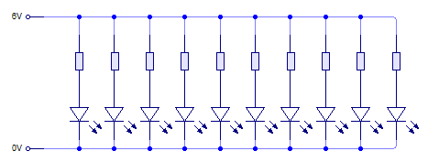
Plan of Action
Investigation into the Problem: What brightness of LEDs would be needed to wake up and to fall asleep to?
Why:
I need to find a good amount of LEDs to depict the same effect as waking up to natural sunlight or to fall asleep to. It would also be used in a lantern to create an effect for a certain aesthetic. I.e. How far should the LEDs be away from the lining of the device and how much power should it take to be produce this.
What am I going to do:
I will test various amounts of LEDs with different amounts of them to produce what brightness would be suitable. I will be doing this by using multiple LEDs to indicate a strength of brightness. For example, one LED will be a strength of 1 and three LEDs will be a strength of 3.
The test will be evaluated by children and by my peers as well. They will give their opinion on what seemed too bright and what seems like a good brightness to fall asleep too.
Prior to the investigation, I would have done research prior to hypothesise what I could potentially do.
Research:
http://uk.businessinsider.com/science-tricks-fall-asleep-faster-sleep-better-2017-4?r=US&IR=T/#12-listen-to-music-12
The source talks about certain things that can reduce insomnia and help have better sleep. A lot of it can be applied to the brightness of the LEDs. Dimming the lights, using candles or just natural light going to natural darkness can help someone fall asleep better. “Bright light — especially blue-ish light — tells your brain that it's still daytime and prevents the release of chemicals critical for sleep, like melatonin.” “Harvard Medical School recommends using dim red lights in the evenings and, conversely, exposing yourself to bright lights during the day to help regulate your sleep schedule.” The source also states that having a sleeping routine will be able to help people fall asleep better. It also suggests to go to bed happy so having lights that are dim and delight naturally (yellow) can help with having better sleep. The source suggests to have a lavender scent or anything related to lavender, an approach is to have various lavender coloured LEDs can help someone be calm and fall asleep faster.
Section 2

Slide 11
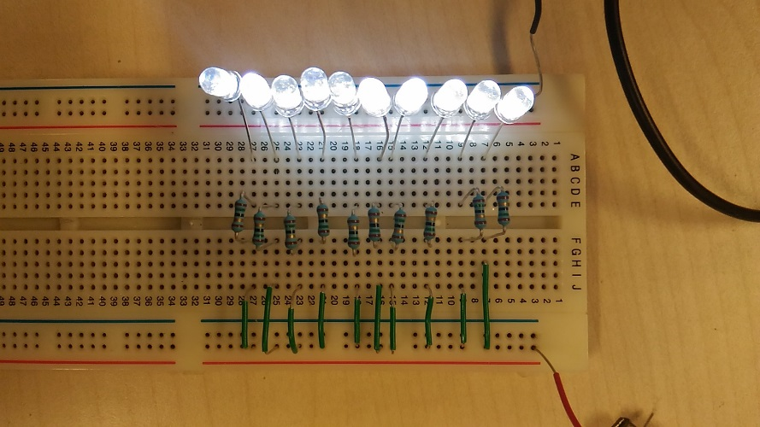
Plan of Action
Investigation into the Problem: What brightness of LEDs would be needed to wake up and to fall asleep to?
Hypothesis:
I think that most people would choose a brightness of 4, this is a good aesthetic and also good reading light. It would be most appropriate to fall asleep to if it became dim over a short period of time for instance 10 mins. But the LED brightness to wake up to should be 9 or 10, it is the maximum brightness and should be able to be a copy of waking up to the sun. The rating for each lighting is “sleep” (for good to sleep to), “read” (good to read to) and “wake up” (which is good to wake up to).
Conclusion:
Most people had thought that lighting from 1 – 4 was a good brightness to sleep or to read to. It was a definite that the lighting at 7 was the brightness to wake up to. The reading lighting was at a brightness of 4 to 6, which means in the product I will need to add parts to make it adjustable for others. However the lighting from 7 to 10 concludes that that should be the brightness to wake up to. Due to the scale of the experiment, this is a very mini scaled version of what could potentially be the product. In the prototype or the real product, we would have twice the amount of LEDs instead of just ten for each part of the product for instance.
Results on people’s opinion on the brightness level of the LEDs
 | Participants | 1 | 2 | 3 | 4 | 5
Brightness of the LEDs | 1 | sleep | sleep | sleep | Read | Sleep
 | 2 | sleep | sleep | sleep | Read | Sleep
 | 3 | Sleep/read | Sleep | Read | Read | Sleep
 | 4 | Read | Sleep | Read | Wake up | Sleep
 | 5 | Read | Read | Read | Wake up | Sleep
 | 6 | Read | Wake up | Read | Wake up | Read
 | 7 | Wake up | Wake up | Wake up | Wake up | Read
 | 8 | Wake up | Wake up | Wake up | Wake up | Wake up
 | 9 | Wake up | Wake up | Wake up | Wake up | Wake up
 | 10 | Wake up | Wake up | - | Wake up | Wake up
Section 2

Slide 12
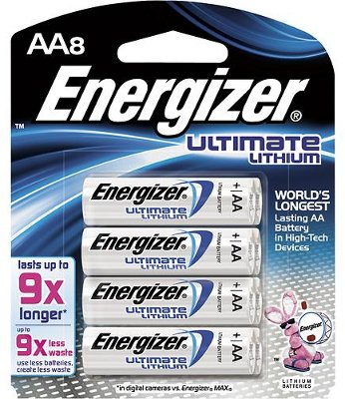
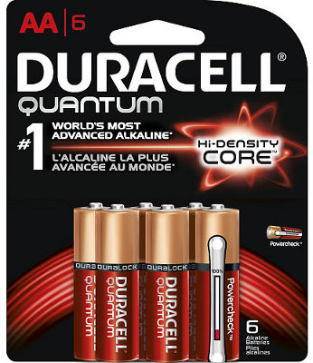
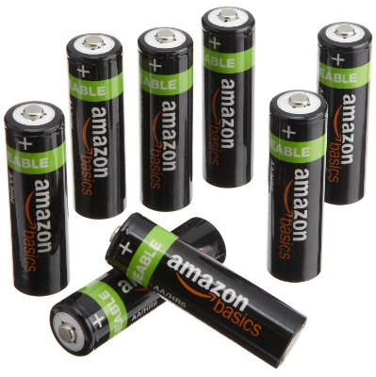
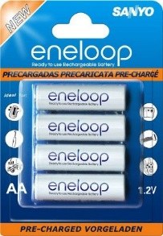
Plan of Action
Investigation into the Problem: What battery would be appropriate for long usage of time?
Why:
I need to find a suitable battery that can be able to last for a long period of time. Even though the initial idea is to be able to switch the device on and off. But it would be used for at least 7-9 hours. Hence the need to focus on what battery I should use that can withstand the time it can be on for. This would essentially be better to have than plugging the device into a socket, the idea of the device is to make this as recyclable as possible and easy to use. It will be a hassle to find a socket to plug the device into.
Batteries that I have looked into:
Energizer Ultimate Lithium
Duracell Quantum
AmazonBasics Rechargeable AA Batteries
Sanyo Eneloop Rechargeable
Conclusion from Research:
Energizer Ultimate Lithium; these are superior to Alkaline batteries. However there are not rechargeable, a lot pricier due to the long shelf life and better performance. ($11.89, Amazon)
Duracell Quantum; the batteries have a longer shelf life (10 years) and can still be used if even it hasn’t been used in a while. ($10.97, Amazon)
AmazonBasics Rechargeable AA Batteries; the batteries are rechargeable and can be done approximately 1000 times. Has an extremely slow discharge rate and capable of being stored for long periods of time. ($18.72, Amazon)
Sanyo Eneloop Rechargeable; rechargeable batteries that have a high longevity and have up to approximately 1,500 cycles of recharging and still have at least 85% power left even when it has not been in use for a while (i.e. a year). Due to their slow discharge rate, they are sold pre-charged in their boxes as well. ($20.19, Amazon)
In conclusion, the Sanyo Eneloop Rechargeable batteries would be the most recommended to use for families as this would be the most efficient to use. The batteries are practical for cost and the efficiency of the power stored. This would be suitable for all families, especially families that do not have a high income.
Research:
http://taperssection.com/index.php?topic=96718.0
The source, which is a forum, has multiple people suggesting that the 9V alkaline batteries can last for up to 24 hours if it is running at a rate of 25mA.
http://michaelbluejay.com/batteries/disposable.html
The source compares the use of Alkaline batteries to Lithium batteries and Carbon Zinc. It states that alkaline batteries are more popular but there are better types of batteries to use instead. The alkaline batteries are harder to recycle as well. It states that lithium batteries hold more power but are more expensive and cannot be recharged, although there are rechargeable 9V lithium ones. It states that lithium batteries are prone to exploding or being at fault. Also that it is hard to recycle them. The carbon zinc batteries are a lot cheaper and have a longer shelf life, also a good battery for clocks and radios.
https://www.thesimpledollar.com/are-rechargeable-batteries-really-cost-effective/
The source compares non chargeable batteries to rechargeable batteries. The sources mainly looks at costs rather than the actual lasting time of the batteries.
Section 2

Slide 13
Clarification of Problem
Moral, Social and Environmental issues:
 | Moral | Social | Environmental
Consumers | The market group; families and children, may not feel as if they are benefitting a lot from the device. The device is not aimed to be a “one size fits all” but instead something that may ease tensions or certain symptoms. Even then, parents may not understand that the device cannot fix everything. The device itself should be used for the children to learn and enjoy what it is, whilst being able to ease the children to sleep or calm down. | The device may be popularized thus meaning a higher demand which would eventually lead retailers to increase the price (making more profit). Families who have children with conditions who are poor may not be able to afford and benefit from the device. | When the device breaks; it would have been made from paper and metal and plastic, which are easy materials to recycle. Families may not recycle them properly. The device should be able to be constructed and destructed easily for the sake of learning and for the sake of the planet.
Purchasers | The purchasers, i.e. the parents, would have the false idea that the device may be able to treat their child’s condition. The device may also be associated with the fact it would have the same benefits to all children with conditions, which is not the case. Different children have different needs and the device cannot fix all of it. | The device could be extremely popular and be made for profit for retailers. This would be a huge concern for families that are poor. | Parents may not be educated or value the importance of global warming, hence the recycling of the plastic, paper and metal in the product may not be done properly.
Retail Outlets | Not every retail outlet will buy the product, it is a specific toy. Even then, some families may not be able to buy them due to the distance from the nearest store that sold this device. | It would be a large profit for retailers for selling the device at a higher price than it should if it was to become popular.
Conclusion:
The aim for this product is to ensure families that they can hopefully ease their child’s symptoms of certain disorders by using this product without being seeing as just a toy. We want to keep this product cheap, for all families to buy, but also be able to make profit out of it. Another main aspect we’d like to keep prominent in the project is to make sure the device can be recyclable and can be made from recyclable materials as well. To tackle this we would look at using cheap recyclable materials and compare what average toys like the one we plan to make are and we can approximate a good value on the product.
Section 2

Slide 14
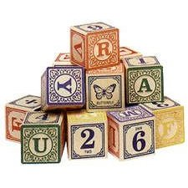
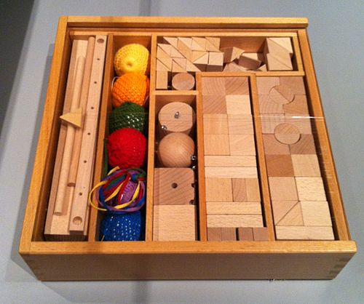

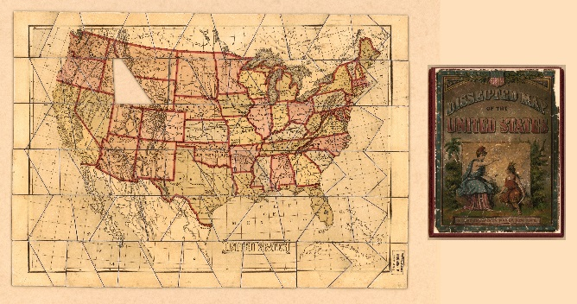
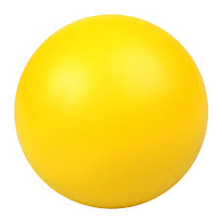
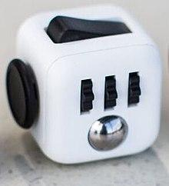
Clarification of Problem
Clients Needs, Trends And Demands
The client will be the children and their families. The needs they would have are that the product should be able to do what we suggests it can do, which is to help regulate better sleep and have a better sleeping pattern, destress children but help energize them when it is needed. The cost for the families should be cheap, this is a product that we aim for “all” families with children with conditions can benefit this from. The production method is going to be a job shop method, this will mean that each product is slightly different to the other but should be the same main design as the other products.
1700s
Locke's Blocks
These were just building blocks with letters of the alphabet on them.
First educational toy
1800s
Froebel's Gifts
Friedrich Wilhelm August Froebel made a bunch of small pieces to ensemble a toy that could help develop the 5 senses.
1990s
Fidget Spinner
Fidget spinners became popular toys in April 2017, although similar devices had been invented as early as 1993
Dissecting Maps
Jeanne-Marie Le Prince de Beaumont made the first official jigsaw toy
Used to increase interest in geography for girls in the 1750’s
1948
Stress Ball
Carswell made the official stress ball 1988. The Stressball contained electronic gadgetry that caused it to make the sound of glass breaking upon impact.
2016
Fidget Cube
The cube is intended to provide an easy way to occupy one's hands and other senses, particularly for self-soothing
Section 2

Slide 15
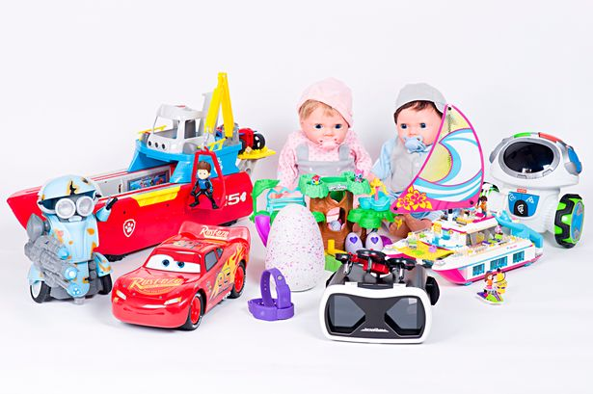
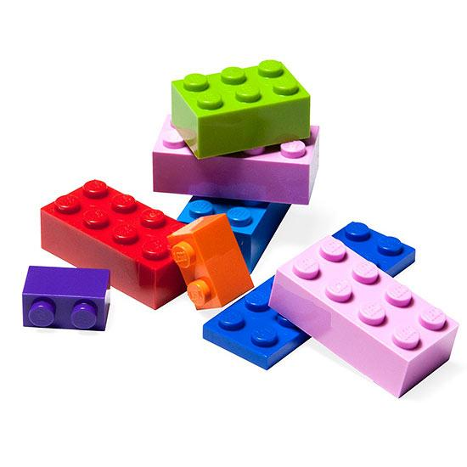
Product Specification
Relevant Authorities
https://www.gov.uk/guidance/toy-manufacturers-and-their-responsibilities
“The main requirements are that toys must:
Satisfy the ‘essential safety requirements’ in the regulations
Be properly marked to ensure traceability
Bear the CE mark
Be accompanied by instructions for use, and warnings where necessary”
http://www.toysadvice.co.uk/toy-safety-standards-uk.html
“There is also an EU wide General Product Safety Directive which provides safety standards for physical and mechanical properties.
Flammability
Chemical properties
Electrical properties
Hygiene
Radioactivity.”
https://www.newcastle.gov.uk/business/trading-standards/product-safety/guidance-on-the-safety-of-toys
“Specifying that products placed on the market or supplied by producers and distributors must be safe;
Defining a safe product
Imposing obligations on producers and distributors consistent with marketing safe products
Laying down a framework for assessing safety
Requiring enforcement authorities to be empowered to take the action necessary to protect consumers from unsafe products”
Conclusion
In order to make the device as safe as possible, we’re limiting the use of flammable parts in the manufacturing. However the main parts we do need is plastic, metal and paper to make the actual device. Tests and research into the materials needed will need to be looked at. There will be a big focus on paper material as paper is flammable, we would need to look at how to reduce the risk of fires or anything exploding in the device.
Section 2

Slide 16
Product Specification
Materials
1.1 The aim is to make the product out of plastic, paper and metal (apart from the use of electrical components that will make the whole product complete
1.2 The aim is to make sure the types of mediums in the product will be recyclable
1.3 Each material has been recycled before use
Processes
4.1 The paper should be done in a job shop manufacturing process
4.2 The metal, the circuitry and the plastic will be done in a repetitive manufacturing process
Product Life
5.1 The product should at least last 5 years, if the product is still in good shape
5.2 It should be able to be repaired and be given at least 2 more years of working
Ergonomics
6.1 The device can be easily placed somewhere and not need to be moved and taken off to alter the lighting
6.2 The switches should be put in appropriate places
Product Cost
7.1 The cost should be the sum of how much each component used cost, the manufacturing process and a small amount of profit
Maintenance
8.1 Does not need to be cleaned daily
8.2 Easy to pull apart and repair
Performance
9.1 The device should rotate at the appropriate speed
9.2 The device should light up at the appropriate times needed
Environment
2.1 The product should not heat the current room temperature
2.2 The product should not be heard when it is on nor off
2.3 The product should light the room it is placed in when it is on
Product Disposal
3.1 The materials should be able to be recycled after it reaches disuse
3.2 The product should be able to be pulled apart after use
3.3 Each of the materials should be identified easily after use and can be recycled into their counterparts
Product Dimensions
10.1 40cm x 40cm x 20cm
20cm
40cm
40cm
Section 2

Slide 17
Initial System Development
Explanation of the Specification:
Materials
1.1 The main point is to make the product recyclable and easy to pull apart or to fix essentially hence the use of just three main materials than multiple.
1.2 This is to make the product more environmentally friendly; this will mean that there will be a need of biodegradable plastics or just most common use of plastic for the product.
1.3 This is to promote recycling and reduce greenhouse gas emissions in the process of making more plastics, reduce the amount of trees that get cut.
Environment
2.1 Heating from the product will ruin the atmosphere of the room, as the device is made to generate a certain vibe and having heat would mess that system. For instance if we need a child to be more positive or more active, heating the room will make the child tired or more agitated.
2.2 This is so that the device does not ruin the atmosphere as we would need children to sleep and the device is made to help that, hence having the device make noise would awaken the child when it is not needed.
2.3 To ensure the device does its job properly, there will be a huge emphasis on what and when the lights are needed to make the most of positive impact.
Product Disposal
3.1 This is to promote recycling
3.2 If the product is ever not working, the product should and can be easily fixed so to do this it will need to be easy to pull apart.
3.3 This is to emphasis the use of recycling.
Processes
4.1 I plan to use paper lanterns to distribute the light in the room. This will decrease the “harshness” of the LEDs and will look more “natural”
4.2 This is will be an effective way of manufacturing the parts together.
Product Life
5.1 The product, if it is liked, will be able to be in use for 5 years (as long as batteries are replaced and added when it is needed). This will reduce the amount of cost it will be for families to keep buying and replacing products, essentially helpful for poorer families.
5.2 If the product is well liked then to ensure more positive reception there should be apart where the device can still work so having repairs can give it more life.
Ergonomics
6.1 This is so that if the device needs to be switched on or off, it can be easy to do so there should be a hook on the device so it can hang from the ceiling and can be easily taken off
6.2 In order for the client to feel like the switches are in the appropriate place, I’ll need to find the most practical and most ease of use for the switches to be on the device. For instance I could put it on the side of the device or on the front of it and put a label as to what and where it is.
Product Cost
7.1 I will need to look into the cost of each component and assess how much I will be using as well as how much it would take to manufacture the device, and to obviously find an appropriate percentage profit the device could make
Maintenance
8.1 The device will not be used in physical activity by the child. It should only be used to look at.
8.2 The product will need to have puzzle like sides to make things attach well, as well as stay put, and be able to pull apart when it is needed to.
Performance
9.1 The device will run at appropriate times, it will not rotate fast and should only rotate slowly
9.2 The device will not light up quite literally on the spot but will gradually light up when it is needed to.
Product Dimensions
10.1 For the product to be able to rotate it will need to have a good distance to cover, however the product needs to be compact and able to not be an interference in the room it is put in.
Section 3

Slide 18
Section 3

Slide 19
Initial System Development
Turn on
Turn on: This will be controlled by an input component on the device and this will start the device
1. LDR senses: So when the device is activated, the LDR will sense what the lighting in the room is to indicate an estimate as to whether it is morning (day) or night. If it is day then this will loop back to the beginning of the program (Feedback 1). It will only change and move to the next part of the program when there is not much light in the room.
Action 1: Once the device detects that it is night, it would start to rotate at a speed of 0.2 metres per second (hopefully 0.3rpm), it would also need to start lighting up gradually with the blue and green LEDs.
2. LDR senses: After the LEDs have been lit up, the LDR would sense whether it was turning into morning or not. If it still is night then it will loop back to action 1 and keep rotating and show the LEDs, this will keep happening until it reaches day (Feedback 2).
Feedback 1
1. LDR senses
Light up
Rotate at 0.3rpm
Speed : 0.2m/s
Blue and Green LEDs
Feedback 2
2. LDR senses
Action 2: When the device detects that it is morning (i.e. when it detects light), the device will rotate slower than it did before and will light up amber, yellow and white LEDs. At the same it will turn off the blue and green LEDs. However this will gradual. So as the amber, yellow and white LEDs are being turned on, the blue and green LEDs will come off at the same time. When all the amber, yellow and white LEDs are fully on and the blue and green LEDs are off, the program will stay this way for 2hrs and then turn off.
Light up
De-light
Rotate at 0.1pm
Speed : 0.15m/s
Amber, Yellow, White LEDs
Blue and Green LEDs
Wait 2hrs
Turn off: Once the device is turned off, it can be turned on again and it will start the program again.
Turn off
Conclusion:
The main aim of the procedure of the product is to make sure that it will turn on and turn off the lights when it needs to. The same goes with for when it needs to rotate. The LEDs will be tested first and then the rotation of the device will be tested, then hopefully a full test of the device will work efficiently.
Section 3

Slide 20
Initial System Development
System : Lighting and Rotating
Input | Process | Output
LDR | PICAXE | LED
The device should be able to detect what the darkness of the room is. This is to enable what lights need to come on for what darkness the room is. | The picaxe programming chip will allow the product to do what it needs to do, i.e. when the room is dark, the LDR will send a signal as to when it is, and the picaxe should recognise and be able to know what to do. That is when it has been programmed to do so. | The LEDs should turn on when it is at certain times, so for instance the yellow and white LEDs should be most significant when it is in the morning. The LDR can pick up when it becomes bright and will alert the child by lighting up the LEDs.
Ultrasonic Sensor | Logic Gates | Lamps
Using ultrasonic would be more precise to measure the lighting in the room. This would be able to detect when someone has entered the room as well, hence making it easier to detect when the device should start working. | Logic gates would be used to help to compare inputs and give a different output. This however would require a lot of logic gates, various ones as well; to create one simple operation like gradually turning off a LED. | Lamps will do the same job as LEDs, however they require more power to run. One of the key spec points in the project is to make sure this device will be as environmentally friendly as possible, meaning we need to reduce the amount of power that could be used in the device.
Switches | 555 Timers | Motor
Using a switch will help the device actually start the program without it having to detect whether someone is in the room or not. It also makes the program work easier as it would not need to detect when the room is empty or not. | Useful for making outputs oscillate or come on for a short period of time. Time periods can calculated with ease to achieve more accurate time periods or frequencies. The circuits are simple to implement and activate, and also attach relays or transistors to in order to switch on high-current outputs. | The motor would allow the product to rotate, there may be a use of gears if there is a requirement to slow down the speed of the motor for the device.
Conclusion:
The easiest solutions to reach the specification points is to use an LDR as the input, have a picaxe microcontroller as part of the process and just LEDs and a motor for the output. This is to be cost effective, and reach less work for more (i.e. no need to have so many parts to try and make the same program in a microcontroller, with logic gates and 555 timers. The use of the LDR as the sole input is so detecting light will be easier than trying make a large program for ultrasonic sensors and also easier for the client to use the device, i.e. no need to keep turning the device on and off when you are in the room.
Section 3

Slide 21
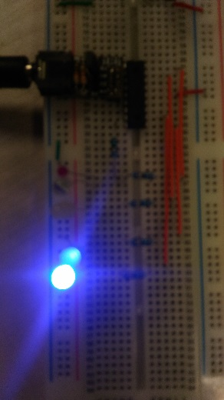
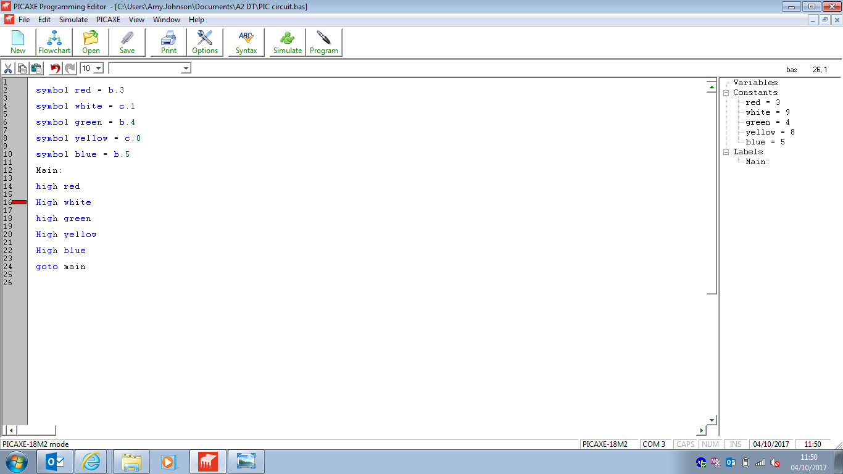
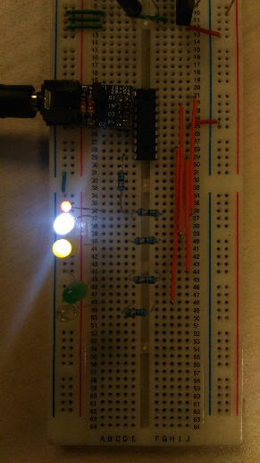
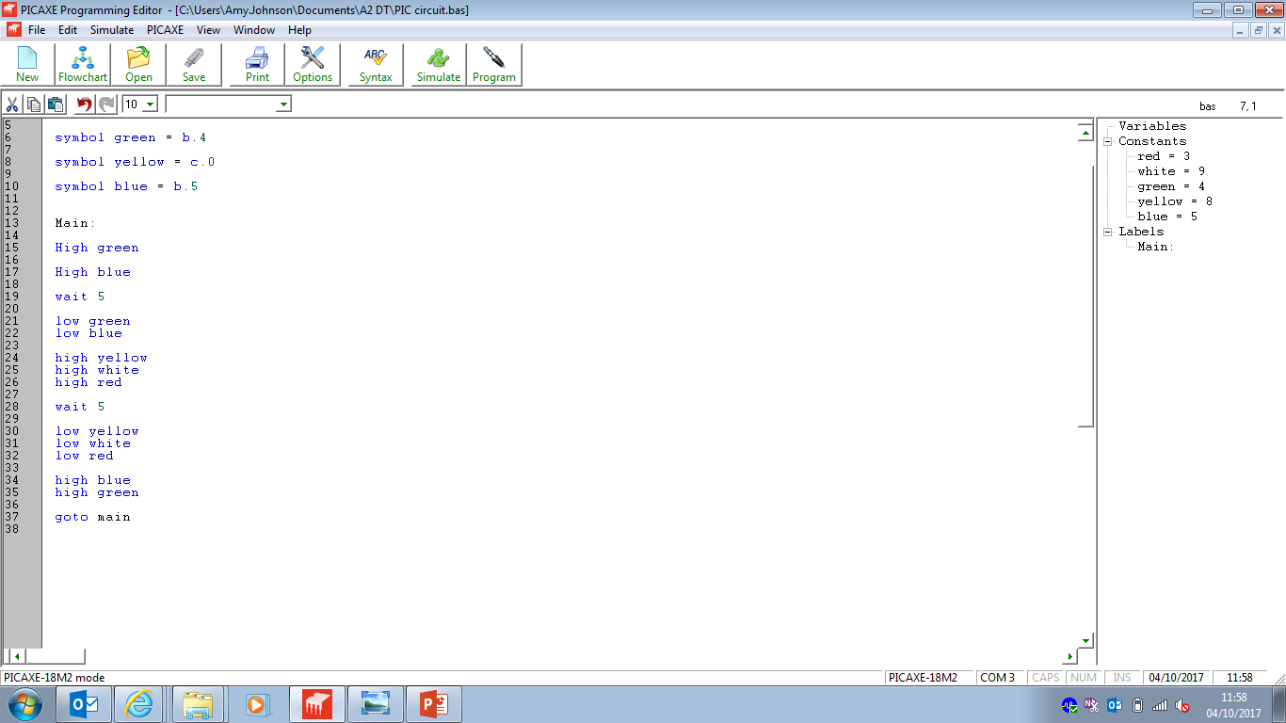
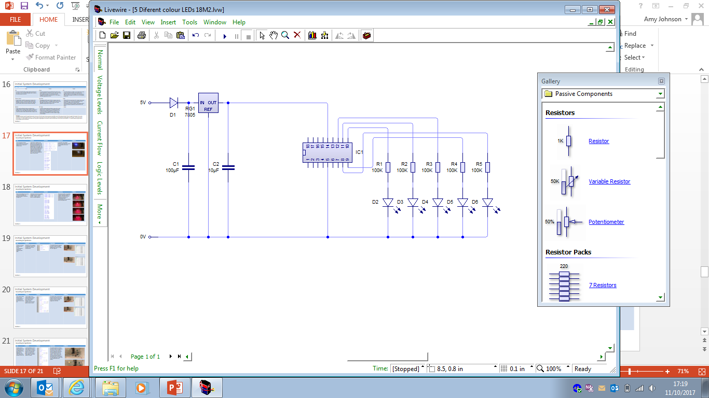
Initial System Development
Researching the Specification
Test | Method | Pictures | Conclusion | Evidence
Test to show that a PICAXE Microcontroller chip can program different LEDs to come on at different times. | I will have the 5 different LEDs (based on the colours given from the experiments before) and will have a group of some come on at different times. For example, I will have red, white and yellow LEDs to come on for a few seconds then same goes for blue and green, however when blue and green LEDs are on the red, yellow and white LEDs will be off. |  | In conclusion, this worked efficiently and proves that a picaxe microcontroller is fit for the product.
Section 3

Slide 22
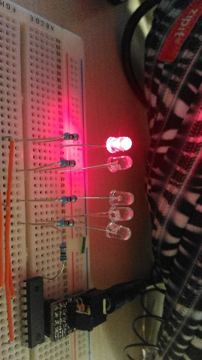
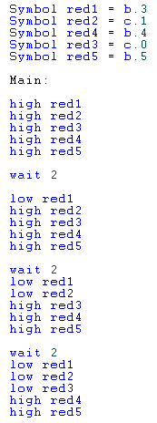
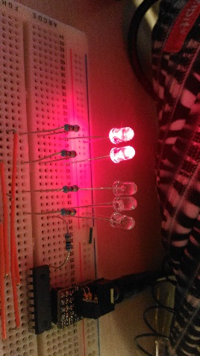
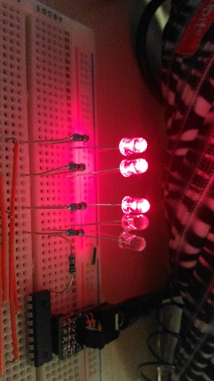
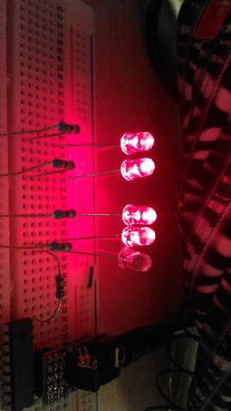
Initial System Development
Researching the Specification
Test | Method | Pictures | Conclusion | Evidence
This is to test whether the use of a PICAXE microcontroller can gradually change the brightness through LEDs | I had used 5 red LEDs and gradually changed them with 2 second intervals. It was run at 6V to ensure a suitable brightness. |  | The picaxe controller can gradually change the lighting through LEDs. However I will need to look into having more output pins or something that could accommodate for the vast amount of LEDs I will plan to use.
Section 3

Slide 23
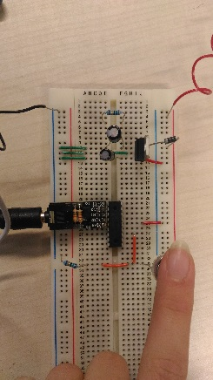
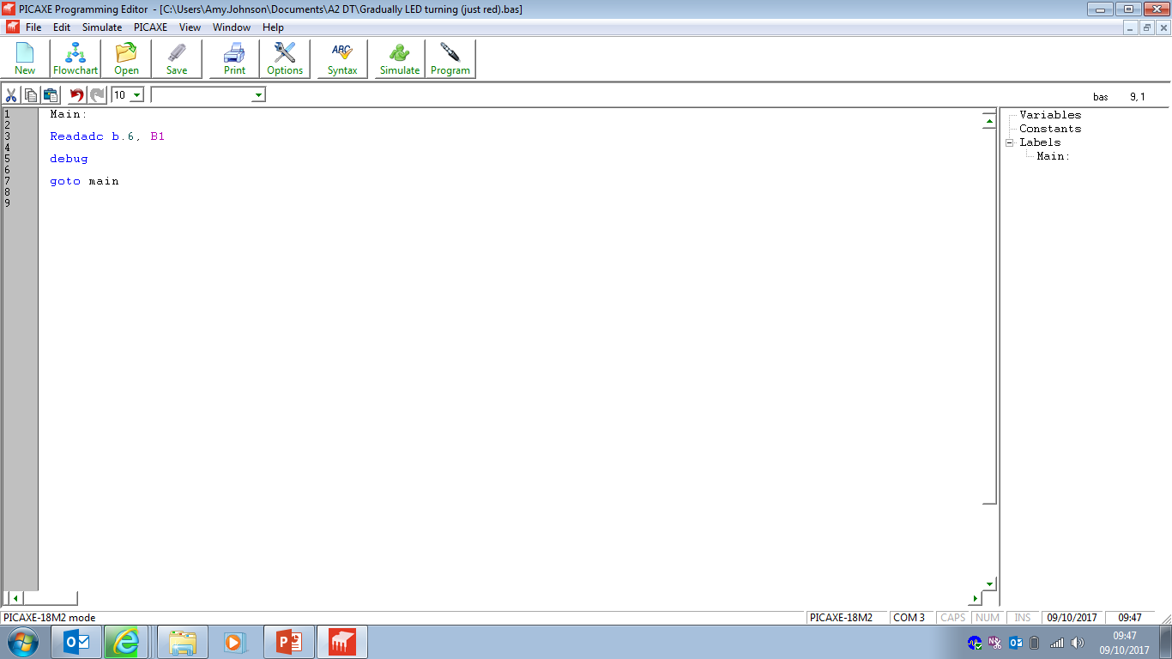
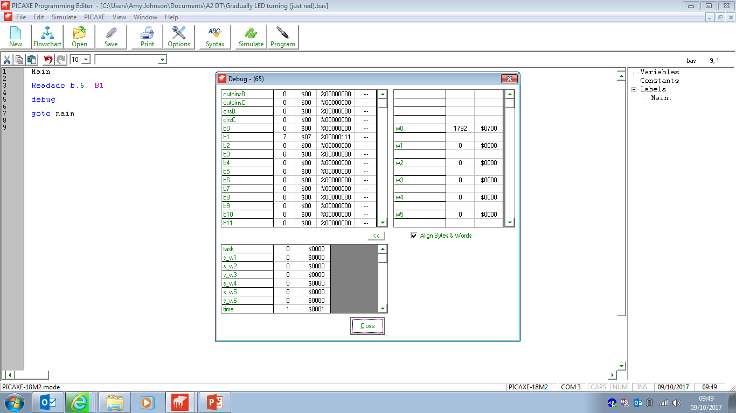
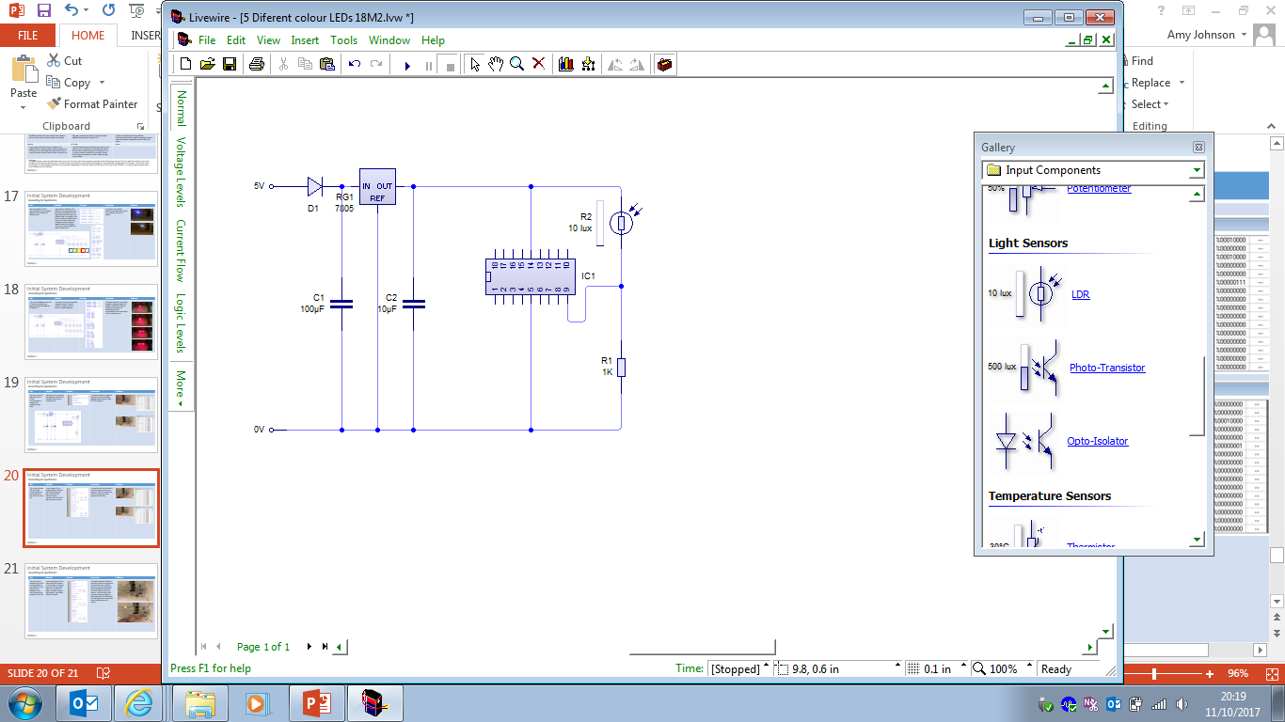
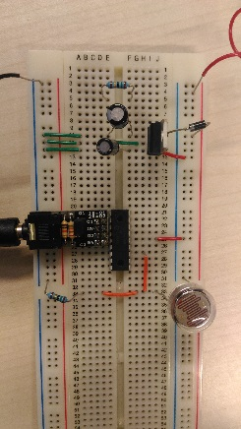

Initial System Development
Researching the Specification
Test | Method | Pictures | Conclusion | Evidence
This test is to ensure that we can use a PICAXE microcontroller to measure the brightness of the room | We used an LDR to measure the brightness instead of an ultrasonic sensor and an infrared sensor. |  | This worked efficiently, however I will need to look into different lightings rather than just “finger off” and “finger on”
Section 3

Slide 24
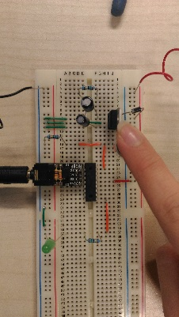
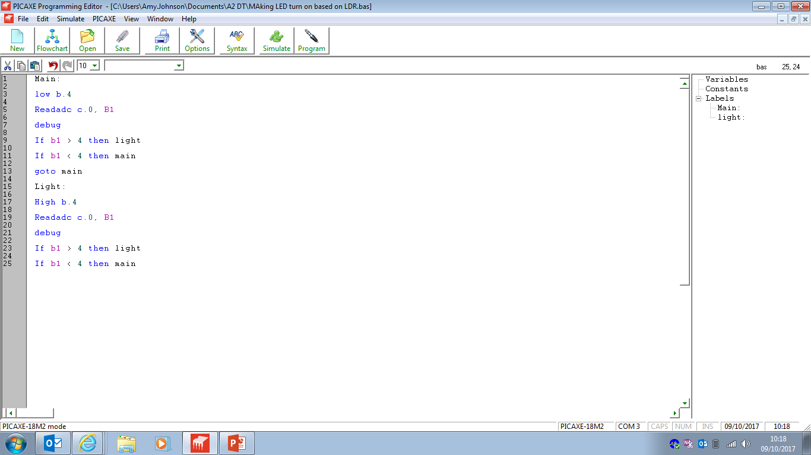
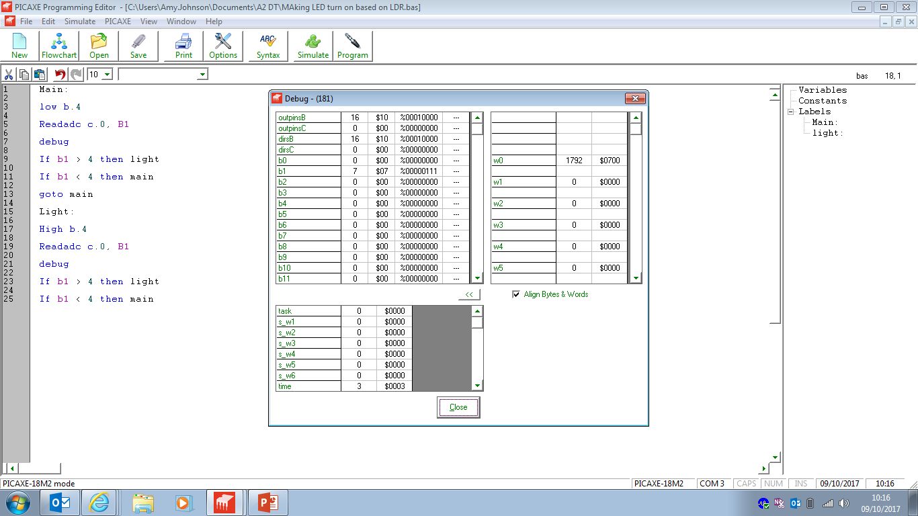


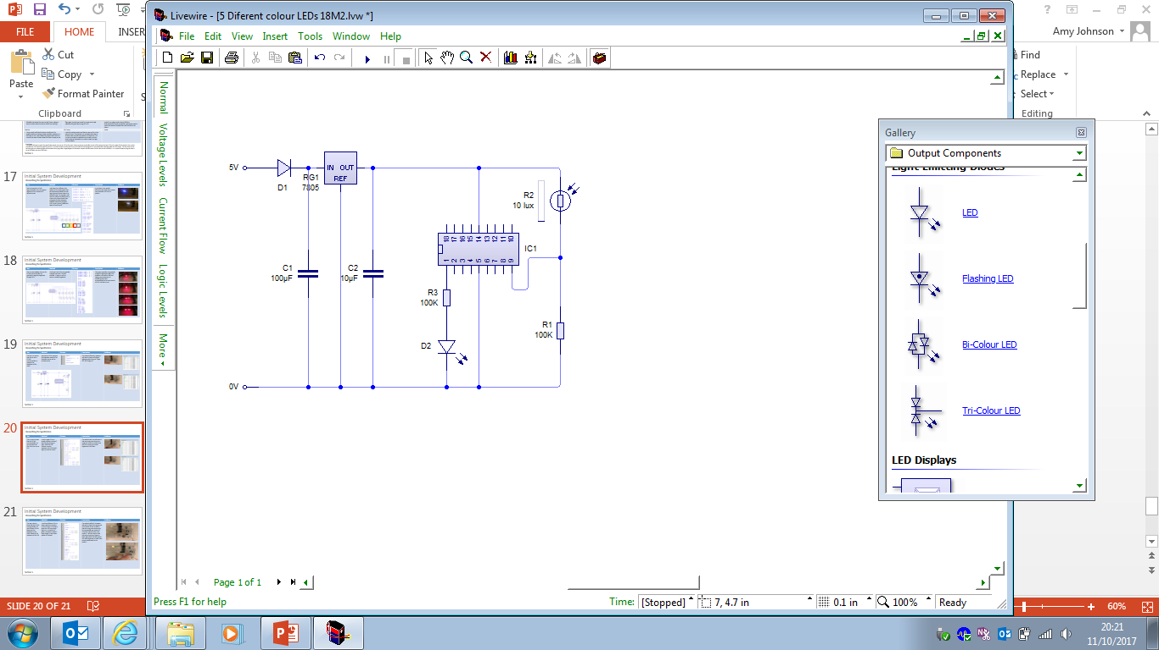
Initial System Development
Researching the Specification
Test | Method | Pictures | Conclusion | Evidence
This is a test to show that the PICAXE microcontroller can use the data from the LDR to turn on an LED | I used a single LED as a simple indicator to show if the LDR was picking up light. When the LDR reaches a certain resistance, the LDR should light up, same vice versa. |  | This worked well, and will need to look into using more than just a single LED to be an indicator that the LDR is picking up certain brightness in the room
Section 3

Slide 25
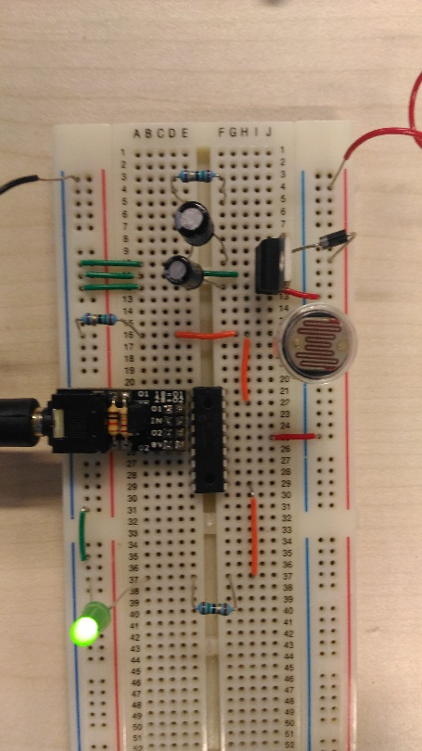
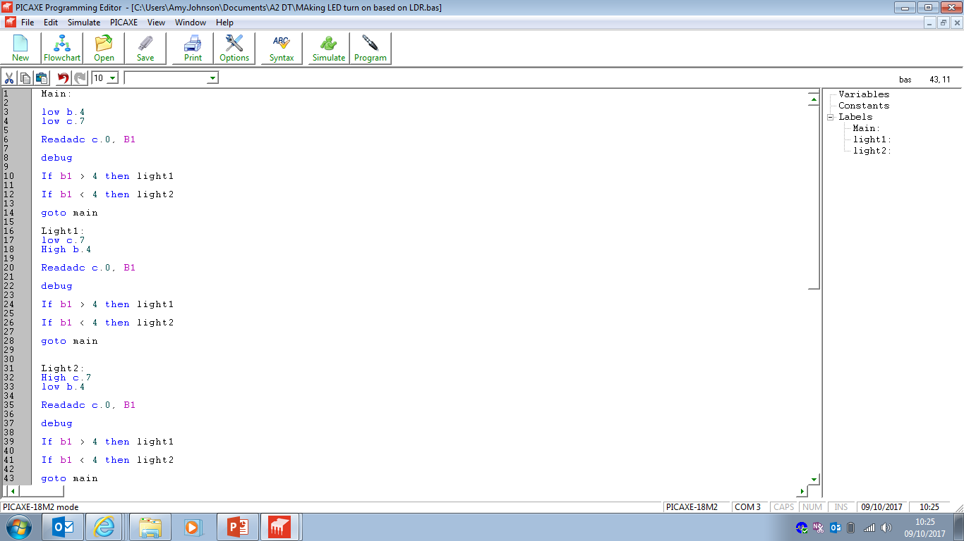
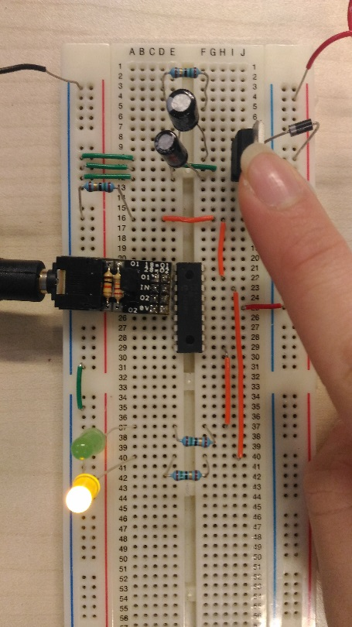

Initial System Development
Researching the Specification
Test | Method | Pictures | Conclusion | Evidence
This was a test to show that the PICAXE microcontroller can use different LEDs to determine the brightness in the room, based on the resistance of the LDR | I used two different LEDs to depict what the resistance in the LDR was. For instance when the LDR has enough light on it, it should turn green. And when it doesn’t have enough, it will show a yellow LED instead. |  | This worked perfectly! However I will need to look into using various LEDs instead of two. As well as look into using more output pins for the possible vast amount of LEDs that could be used in the product. I will also need to look into not just using my finger to block light off the LDR but instead the room brightness to make more precise adjustments to the product.
Section 3

Slide 26



Initial System Development
Calculations:
5 different type of LEDs
9 LEDs for each different type
5 x 9 = 45 LEDs needed.
Researching the Specification
Due to the amount of LEDs I intend to use, I would need to use a circuit that can accommodate to this.
Idea 1: To use a bigger PICAXE chip.
From the previous step in the initial system development I had used a 18 pin Picaxe chip. However with the amount of LEDs I am going to use, (5 different colour LEDs and use 9 LEDs for each colour; will be using 45 LEDs), I need to use a picaxe chip that can hold that many outputs as well as my two main inputs (the battery storage and the LDR).
An idea to tackle this problem is to just use a bigger picaxe chip such as a 20 pin, 28 pin and a 40 pin.
Idea 2: To use the multiple smaller PICAXE chips.
This idea is to still use the same pin type of picaxe chips but link them together to work.
The idea could be cheaper than using a bigger microcontroller
The price for a 8 pin PICAXE chip is £1.88 and the price for a 40 pin PICAXE chip is £5.61
To use 3 8pin chips, it would be a total of £5.64
Conclusion:
In order to combat the issue of using that many LEDs, we will need to use a bigger microcontroller. I will looking to the research and compare and analyse the different picaxe chips to see which is needed. This will be made by looking at cost, space and also the storage space and data it can hold.
Section 3

Slide 27



Initial System Development
Researching the Specification
Due to the conclusion I made from the previous slide; we will only be looking at the 20m2, 20x2, 28x2 and the 40x2. (Where I had stated that I would only be looking to use bigger picaxe chips rather than using smaller chips and using multiples one to create on big picaxe chip)
The 20m2 and the 20x2:
With this pic I am only able to have 16 pins available to use. Hence this would not be appropriate to use. As I will be need to use possibly more than 15 pins.
The 28x2:
The pic is able to have 20 pins to use: 4 inputs, and 16 output pins. The price for this pic is £5.61. The microcontroller chip is a longer version of the regular picaxe chips (the 8m2, 18m2, 20x2)
The 40x2:
The pic is able to have 32 pins to use: the price for this pic is £5.61. The microcontroller chip is a thicker version, width-wise, of the regular picaxe chips.
Conclusion:
In conclusion; it would be best to use a picaxe 28x2 as this is the most efficient use of the board and as doesn’t take as much space as it can on the PCB. The PCB needs to be as small as possible. However in the event of having multiple or spare pins to use in the product, the 40x2 chip would seem perfect to use.
Calculations:
5 different type of LEDs
9 LEDs for each different type
5 x 9 = 45 LEDs needed.
Table of Data of the Picaxe chips:
http://www.picaxe.com/What-is-PICAXE/PICAXE-Chip-Sizes/
Section 3

Slide 28









Plan of Manufacture
Researching the Specification
Ergonomics;
The product should help combat issues such as sleep deprivation, ADHD, anxiety and bipolar disorders and conduct disorders. Mainly focusing on diminishing the symptoms associated with these disorders.
An idea is to use colours to help stimulate certain feelings and emotions, such as using blue to help promote being calm and feeling more relaxed. This is has been researched in section 2 of the project where I looked at different coloured LEDs and had children give their opinion of the colours.
Conclusion
In conclusion, from the research done and given, we are going to use 5 different colour LEDs. These colours are green, blue, white, red and yellow.
The reason for using yellow and red is to help promote being awake so these types of LEDs will be used in the morning part of the program. The green and blue LEDs will be used to help feelings of relaxation and might be able to help children fall asleep. The white LED will be used to help bring more brightness in the room, so make children either fall asleep faster or wake them up quicker.
I have created a mood board which could help elevate the issues of what to do for the design and aesthetic aspect of the product.
The main concept for the product is that it should be able to rotate and produce different coloured lights depending on the brightness of the room.
With this idea I will have to keep in mind that I will need to develop a design that can help rotate the product and also make sure the LDR can sense the brightness of the room without being interfered with by the LEDs.
I will also need to focus on the ergonomics so that the product can be used by a child as well as the parent. I will have to look at colour schemes. Another part I will need to focus on is to create a theme or look for the product that will appeal to children and have a very all round theme that can appreciated by all children.
Blue and green LEDs for relaxation and calmness
White LED for brightness
Yellow and red LED for feelings of being awake and more energized
Section 3

Slide 29




Initial System Development
Researching the Specification
Test | Method | Pictures | Conclusion | Evidence
This was a test to see whether I could maximise the use of the outputs of a PIC 28X1 to accommodate the need of using a lot of LEDs in the project. | I would make a set of branches from one output of the PIC and put as many LEDs (I think necessary) that could be used to light a lantern. I put four LEDs on an output branch and did so for different colours needed. |  | In the end it was successfully and will be used in the project. However instead of using four LEDs on a branch, I would used three LEDs instead of four and also have three branches of each LED colour. 3x3 white LEDs 3x3 red LEDs 3x3 green LEDs 3x3 yellow LEDs 3x3 blue LEDs
Section 3

Slide 30



Initial System Development
Researching the Specification
Test | Method | Pictures | Conclusion | Evidence
This was a test to put the plan so far into action: i.e. to use three LEDs on a branch and see whether it would be a successful lighting system. | I would put three LEDs connected to a single output and do the same for three branches of the same colour LED. |  | The program worked effectively. This would be used to develop the main program and coordinate what LEDs go with which output port on the 28X1.
Section 3

Slide 31

Initial System Development
The main ‘jist’ of the program
Category 1: lights all on
3 Red LEDs
3 Yellow LEDs
3 White LEDs
Category 2: 1 light off, 2 lights on
2 Red LEDs
2 Yellow LEDs
2 White LEDs
Category 3: 2 lights off, 1 light on
1 Red LED
1 Yellow LED
1 White LED
Category 4: lights all off
No LEDs are on
Category 1: 2 lights off, 1 light on
1 Blue LED
1 Green LED
1 White LED
Category 2: 1 light off, 2 lights on
2 Blue LEDs
2 Green LEDs
2 White LEDs
Researching the Specification
Live wire diagram
This was a test to reveal whether the use of an LDR would be compatible with the main program (i.e. the previous test program); with alterations to the program.
What I did was assemble different LDR input readings based on the lighting in the room. There are 4 main categories. The first category is when all the lights are on. Meaning that the red and yellow LEDs would be on. The white LED would be on as well.
The categories go down each by lighting difference, the last category is the fourth. This is when it is dark, meaning all the LEDs are off. The program loops to another lighting category so that when it detects light (after being ‘full’ dark) it will show green and blue light instead of the red and yellow.
Category 3: lights all on
3 Blue LEDs
3 Green LEDs
3 White LEDs
Section 3

Slide 32










Initial System Development
Researching the Specification
Category 1
3 Red, Yellow, White LEDs on
Category 1 (2)
3 Blue, Green, White LEDs on
Category 2 (2)
2 Blue, Green, White LEDs on
Category 2
2 Red, Yellow, White LEDs on
Category 1
3 Red, Yellow and White LEDs on
Category 1 (2)
3 Blue, Green and White LEDs on
Conclusion:
The test worked effectively, this is now the updated main program.
The program works effectively with the lighting, it was quick to transition between the categories.
For instance; when you place your hand on top of the LDR: the red, yellow and white LEDs go off. Then once you take your hand off the LDR: the blue, green and white LEDs turn on. Even when you place your hand back on the LDR: the LEDs are all off. Then once you place your hand off the LDR: the red, yellow and white LEDs come back on.
Category 3 (2)
1 Blue, Green, White LEDs on
Category 4 (2)
No LEDs on
Category 3
1 Red, Yellow, White LEDs on
Category 4
No LEDs on
Section 3

Slide 33



Initial System Development
Researching the Specification
Look at using motors in the product:
Idea 1: Example of fidget spinner
An idea for the product to rotate is to not include the motor at all and allow the product to move from the users will. Much like a fidget spinner where there are three plates and the middle plate is the piece that actually rotates, it could minimise the use of making more programs and also means we don’t need to invest in using a motor.
Idea 2: Ferris Wheel example
A possible idea is to make the product just rotate on one whole plate at a vertical angle. Much like a Ferris wheel, the lights could be positioned equally around the circumference of the circle plate and create a Ferris wheel sort of lamp.
Idea 3: Have a rotating plate
An idea is to just use one plate and make that rotate with the lights on it, it will be on a horizontal plane instead. This is inspired by a fishing rotating board game.
Conclusion:
Idea 3 is the most appropriate to use as it is the easiest to do and to make and easiest to program as well. Idea 1 would prove to be difficult as I intend to make this product be placed in high places/spaces of a room and so a child or parent could not be able to rotate this product all the time. Idea 2 could have been appropriate however I intended for this product to make as much light as possible in the room it is occupied in. With a Ferris wheel idea, this can only be placed on a wall and can only occupy a minimal amount of space as a horizontal rotating plate could.
Idea 2
wall
ceiling
Idea 3
Section 3

Slide 34


Initial System Development
Fault Finding:
When making the program, I made the decision to not make the motor run at specific times but instead make the motor run throughout the whole time. This is so that there is less to program and also that there is less confusion when trying to fix problems with it.
So, I decided to connect the motor to the voltage regulator + volts and to the ground directly. This allows more output ports to be used and also less to program.
The new proposed Livewire Diagram:
Researching the Specification
Live wire diagram
This was a test to reveal how to best use the motor with the pic 28X1. The motor should run when it is connected from a high voltage to a lower voltage. I.e. from + voltage to negative or ground.
What I did was connected the motor to an output port of the pic 28X1 and connect it to zero volts rail. This was made so that in the program the motor can run at specific times. For instance when the LDR detects that room is bright, the motor will keep running. However when the LDR detects the room is dark, the motor will stop running.
Section 3

Slide 35


Initial System Development
Researching the Specification
Conclusion:
The test worked effectively, this is now the finished program.
The motor works well. The motor runs quite slowly, thus giving less work to deal with. (If I had a motor that was faster that the one used in the diagram, I would need to make gears that would make an appropriate slow rpm).
I will need to take note of what model motor I am using, and how make rotations per minute it makes.
Finished PCB on Breadboard
Finished Livewire Circuit Diagram Of The Product
Section 3

Slide 36


Plan of Manufacture
Comparison and Conclusion
The predicted board seemed too complicated and had all the LEDs to one side of the board. This did not fit with my plan of what the product should look like. I need to have different colour LEDs on different sides on the product, and PCB to distribute a large light effect.
The predicted board is too big for the actual specification of the product (needing to the PCB to be as small as possible). This is so the casing can be varied in length for specification.
I have enhanced the board so that it is small enough to fit all the components needed and also enough space for each of the component metal rails to not touch each other. I have also made sure that the LEDs are placed on different sides of the PCB board rather than having it all on to one side.
The predicted PCB board did not have wires connecting to other components like the LEDs could all be linked to zero volts rail. I have changed this accordingly. I have also used as much space needed by making the wires go through the picaxe chip as well.
Researching the Specification
PCB Wizard App Prediction of what my PCB should look like:
Finished Printed Circuit Board of the Product
7.4 Inches x 7.4 Inches
15cm x 15cm
Section 3

Slide 37



Plan of Manufacture
Picture of PCB before solder
Researching the Specification
Making the PCB itself:
The PCB is made when the board itself is printed on acetate. Once the acetate has been printed the print is placed onto a photo sensitive board and the board is cut according to the acetate print. So they are roughly the same size.
Once this has been done, the black film on the board is removed and place into an ultraviolet lightbox with the acetate on. This will make the board’s chemical coating be removed from the areas that are exposed to the ultraviolet light. The chemical coating that has not been stripped are the tracks and component pads from the software PCB.
The board will then be put into an acid tank with a solution, then into another acid tank but will be sprayed with ferric chloride to dissolve the copper off the board that are not on the tracks or the component pads.
When the board has been developed, the board will be ready to be drilled.
The drill bit is 1mm for all of the component pads. To remove the coating on the tracks, I used wire wool.
After the board has been drilled, the board is ready to be soldered. I was quite messy with my soldering, however in the actual making of the product when it made in a factory the soldering will be a lot neater.
Pictured of PCB finished
Section 3

Slide 38





Initial System Development
Researching the Specification
Evidence and Ideas for the product:
Research into the design of the product:
The main product is to replicate a visual look of a solar system. Meaning it should have a circular shape in regards to the movement of the product or the actual shape of the product.
What I need the product to do is to accommodate the look of a solar system. A main idea is to look at using the LEDs in a lantern. The lantern can be possibly made of tissue paper mache, or from recycled newspaper as this would be useful for meeting one of the specification points. I.e. making the product recyclable.
In order for the product to rotate I will need to make a gear in which I can attach the LEDs to rotate on. If I plan to use multiple gears to make different LEDs rotate at different speeds then I will need to look more into that and make more calculations and such.
The colour scheme should be dark as this is a lamp that should blend in with the environment. However for the LEDs that are a brighter colour like red, white and yellow the lanterns should accommodate to those colours.
Section 3

Slide 39


Plan of Manufacture
Researching the Specification
Pros
It makes using the motor to rotate the device easy as it will only need to rotate one plate
The branches holding the lanterns are placed on to one plate, this means I don’t need to hassle with making multiple plates.
The lack of materials needed for this means there’s less material costs, meaning the device would be relatively product cost effective
Cons
It might be too simple for the product; there could be a use of multiple layered plates to make different lanterns move at different speeds.
Pros
It uses slightly less materials to make all the lanterns move at individual speeds; this is accomplished by making two layered plates. One layer will have just two branches and another layer will have
Cons
I would have to use more materials to produce the outcome of the plan and it would require more money
I would also need to alter the branches for each part as some need to be shorter than others and also I would need to calculate the speed for both rotating plates to turn at. It would also be a hassle to know if whether I want to make one plate rotate faster than the other.
Section 3

Slide 40

Plan of Manufacture
Researching the Specification
Pros
It’s cost effective if the aim is to make the children focus on the product, as the layers and varying speed of the each layers would make it an interesting thing for the children to look at
Cons
It might be too much to produce, I would need to individually produce different parts as each branch has varying lengths so that the lanterns do not knock into each other as they rotate.
There would be too much to calculate and it would need to be exact measurements so the lanterns don’t knock into each other, this would cover the calculation of speed of each layer being rotated and how big each branch must be.
Producing this much would be more expensive to make than it is to sell and does not fit the cost specification.
Conclusion
Design 1
It’s cost effective compared to design 2 and 3. The other designs would use more money to produce as there are individual parts that would need to be produced rather than having same pieces to use.
It’s effective for constructing, design 2 and 3 would need to have more individual parts to calculate and this is also going to take a process as it needs to be precise and accurate; the designs themselves require different branch lengths so that the lanterns do not knock into each other
Another reason design 1 was chosen is due to the simplicity of the motor rotation; regardless of the branch lengths individually, if we kept all the plates (design 2 and 3) to rotate at the same speed, it would essentially be a more expensive and more producing-time to just show one plate of all the lanterns rotating at the same speed.
Simply: 1 Plate of 5 lanterns is the same as having 2 plates or more rotating at the same pace as 1 plate.
Section 3

Slide 41
Plan of Manufacture
This is what I predict the product should roughly look like. I’ve taken on certain ideas from the previous plans I’ve made and the research I did behind solar system themed toys and devices. As well as looking at the shape of what lanterns to make.
Due to the limitations of certain skills, i.e. making a circular shape with the 3mm plastic. I have opted for a square shape as this will be easy to hold and interlock with pieces to assemble it. A circular shape would not be able to do teeth in the pieces, thus proves difficult to deal with.
Researching the Specification
Predicted Side view of the product
20cm
40cm
Top (Above) view of the product
40cm
Bottom view of the product
Section 3

Slide 42



Plan of Manufacture
Researching the Specification
This is the box that will be used as a rotating plate for the PCB. A hole will be drilled so that the rod from the motor will fit in ‘perfectly’, i.e. firmly fit in.
The battery can be replaced from the box, the ‘rectangle’ is where the battery door will be and it should be easy to open as I plan on using a slider to be able to hold the batteries.
Card will be used as the testing if the layout of the 2D design works. When the 2D design works, then the plastic will be laser cut.
Box 1
Card Version
15cm
5cm
Acrylic Plastic Version
Section 3

Slide 43



Plan of Manufacture
This is the ‘box’ that will connect the ‘branches’ to the main PCB. This box will also be attached to another box to act for a plate to rotate on. The LDR is placed in the corner of the box as this will detect optimum light and also see the significant decrease of light in the room.
The lights are arranged so that there are four lanterns and one of each is one of the sides of the box. The white LED lantern will be placed in the middle of the box, as shown by the circle created. The Lantern should be able to be held and fit in the circle cut.
I am going to do fix the branches onto the box, I have designed them so that the pieces (3mm) will fit on top and still allow the wire LEDs to fit.
I am going to hold each piece of the box with glue as this makes a firm shape of the box.
Researching the Specification
Box 2
Card Version
Acrylic Plastic Version
5cm
20cm
Section 3

Slide 44



Plan of Manufacture
Researching the Specification
The branches are made so that 2/3 of the ‘box’ is not connected to Box 2 . Then the 1/3 of the box will be connected to the box, and will be connected by glue for firm fitting.
The branches have a hole to have the LEDs from Box 2 and there is also another hole at the other end of the branch to move the LEDs to the lanterns.
The lanterns will be held be metal fold it in and also from the branches, the metal will be glued in the branches.
The boxes and branches are made from 3mm black plastic, given the use of the DT lab. The black is use so it ‘camouflage’ with the dark, when the child is sleeping.
The lanterns will be painted accordingly to the coloured LEDs.
Branches
Card Version
Acrylic Plastic Version
5cm
10cm
10cm
Section 3

Slide 45



Plan of Manufacture
Researching the Specification
Production of the lanterns
The lanterns will be made using recycled tissues, as stated to promote recycling, and will be used with Polyvinyl acetate glue. This will provide the outer laying of the lantern.
To make the lantern into a spherical shape, I used a balloon to make the shape. I put the tissue (soaked in PVA glue and water mixture) onto the balloon and wait for it to dry. I created one half of the mould and another half, I then paper ‘mached’ them together to create a spherical shape.
I then painted them with a ‘3:5 ratio of water to paint’ mixture.
Things I could have done:
I could have used an actual sphere to be the mould of the paper mache, but due to the limitations of the DT lab I am working in, I could not find one. I had the idea of using a hockey ball to be the mould, however this would prove to be difficult as it was too small of space to hold all the LEDs.
I could have also made a full sphere with the balloons instead of creating the paper mache to cover only half of the balloon, this would however give a 3D oval shape. This was not what I was going for.
Predicted Shape of the Lanterns
Example of practice Lantern mould:
The Lanterns (not painted):
The Lanterns (painted) and the poster paint:
Section 3

Slide 46

Plan of Manufacture
Researching the Specification
Child and human size comparing with product.
This is a size comparison of the product with different aged humans.
This is to show how the product should be and how appropriate it is for use. The product will be quite light, so all ages can use it.
1.77m
1.65m
1.38m
1.02m
20cm
Female Adult
Male Adult
10 year old
4 year old
40cm
Section 3

Slide 47
Section 4

Slide 48


Plan of Manufacture
Task | Making the PCB
Materials/Tools | Computer, A PCB making software, Circuit diagram software
Process | Build the circuit on to the circuit diagram, in this case ‘Livewire’ was used. Once that has been constructed, use that diagram to help construct the PCB as to where to place the components and rails and tracks
Risk Assessment | None
Health and Safety | Don’t spend too long looking at a computer screen and take regular breaks if it is going to be used in a long amount of time, stay hydrated.
Quality Control | To ensure that the quality of the PCB is not compromised, the PCB board itself must be compact but has reasonable space in between each tracks and such so that when it comes to soldering on the pieces the solder isn’t too big that the solder connects multiple wires and such.
Timescale | At least 1 hour to the maximum of 2 hours.
Evidence:
Section 4

Slide 49





Plan of Manufacture
Evidence:
Task | Developing the PCB
Materials/Tools | Acetate, Printer, Photosensitive board, ultraviolet light box
Process | PCB should be printed on acetate The printed acetate will then be used on a photosensitive board, this will act as a guide as to how big the photosensitive board should be cut to accommodate to the PCB. The acetate is left on the photosensitive board and the board will then be placed into a ultraviolet light box. The board’s tracks and rails should be stripped, the board will be placed into a solution for roughly a few minutes When finished the board, and wiped down with tissue paper, it will then be put into an acid tank (sprayed with ferric chloride) for roughly 3 minutes at most When the 3 minutes are done, the board should then wiped down with tissue paper, and rub wire wool on the board Drilled according to the component areas with a 1mm drill Wipe down the board again to get rid of dust
Risk Assessment | When dealing with ultraviolet light, it could lead to problems if skin is over exposed. When dealing with acidic solutions, it could be an irritant to skin if not handled properly or worse if digested When dealing with drilling, if not used properly and carefully it could potentially cause injuries
Health and Safety | Dealing with ultraviolet light; limit the amount of time skin is exposed to the light as necessary as possible. Dealing with acidic solutions; wear lab coats and googles. Remember to wash hands after usage, very thoroughly. Dealing with drilling, wear googles and don’t rush the process. Need to be able to see properly to reduce the risks.
Quality Control | To ensure the quality, the board should be kept at the minimum and in between the maximum times of usage at each task. This is to make sure the tracks are opaque as possible, i.e. enough copper is showing, and also so that copper isn’t full stripped off the board. The wire wool when rubbed onto the board, should not be pressed too hard or rubbed too hard as it may scratch of the copper tracks. When drilling, the 1mm drill should be placed exactly where the hole (shown from the component area) should be.
Timescale | Should take at least 5 hours to make and 7 hours at maximum.
Wire wool
1mm Drill part
Drill
UV Box, and Acid tank
Ferric Chloride
Section 4

Slide 50





Plan of Manufacture
Evidence:
Task | Finishing the PCB
Materials/Tools | Solder, electrical components need for the product.
Process | Put the components on to the board, so the wires go through the holes and the components are on the opposite to tracks of the PCB. Solder the pieces on
Risk Assessment | Burn hand or skin when in contact with melted solder. Could potentially burn eyes when dealing with the heating of the solder. Could burn skin or other appliances when the soldering iron is on.
Health and Safety | Wear lab coat to decrease the chances of melted solder, or the solder iron, come into contact with skin. Wear safety googles in case the solder spews any hot liquid. Make sure you use the non-heated part of the soldering iron for soldering.
Quality Control | The solder should cover the wires of the components, at least to prevent it from falling out of the PCB. The solder should be big enough to cover the component area holes but also small enough that the solder does not come in contact with other tracks, so that the program does not alter or that we burn a component.
Timescale | Should take at least 5 hours to make and 7 hours at maximum.
Soldered PCB
Soldering Iron
Soldered PCB (with components)
Section 4

Slide 51





Plan of Manufacture
Evidence:
Task | Making the Casing
Materials/Tools | Computer, CAD (computer aided design) software, Laser Cutter
Process | Measure what the product needs to be (in this case, 40cm x 40cm x 20cm), adjust calculations to fit with the CAD software Assimilate the casing onto the software Print off the software casing onto card using a laser cutter Assemble the pieces to make a 3D object
Risk Assessment | None
Health and Safety | Don’t spend too long looking at a computer screen and take regular breaks if it is going to be used in a long amount of time, stay hydrated.
Quality Control | To ensure the quality, It is made sure that the card copy of the casing fits exactly and works accordingly to the requirements of the product and also fits as it interlocks. If not, the casing on the CAD software must be altered to work.
Timescale | Should take at least 1 hour to 2 hours maximum
CAD Software (2D Design)
Laser Cutter
Section 4

Slide 52



Plan of Manufacture
Task | Assimilating the Physical and Final Casing
Materials/Tools | Acrylic Plastic 3mm thickness, Laser Cutter, masking tape, heavy stands/objects, Solvent Solent (glue), paint brush
Process | Print the final casing on the software onto 3mm thick acrylic plastic using a laser cutter When all the pieces have been cut, use masking tape to hold the pieces together before gluing them together When all the pieces fit and are laid out, glue each piece together Use heavy objects to hold the pieces together as the glue dries. When the glue is dried, take away the objects/stands
Risk Assessment | Accidentally laser cutting people. Gluing skin for prolong time Dropping heavy objects
Health and Safety | When the laser cutter is on, stand back from the machine to reduce the risk. Use gloves when gluing and also avoid, as much as possible, skin contact with the glue. When using the heavy objects, make sure they can be carried comfortably so reduce the risk on dropping them and place them in areas where they cannot be easily dropped.
Quality Control | To minimise the risk of the pieces not be glued at 90 degree angle, use the heavy objects (such as books or a wall) to create a perpendicular shape. This is so that the pieces glued together can also create a perpendicular shape as well.
Timescale | Human effort, should be at least 3 hours to 5 hours. When dealing with the drying of glue, could approximately take 8 hours to 10 hours for stiffness.
Evidence:
Solvent Solent and paint brush
Section 4
Acrylic Plastic

Slide 53



Plan of Manufacture
Evidence:
Task | Assimilating the lanterns
Materials/Tools | Polyvinyl acetate glue, recycled tissue paper, balloons, paint brushes, poster paint (red, white, yellow, green and blue) , water, glue spatula, beaker
Process | Blow balloons to reach at least 8cm to 11 cm diameter. Mix the pva glue and water together to a ratio of 1:2 in the beaker Rip the recycled tissue paper into small pieces, roughly 7cm x 3cm Use a paint brush to apply the glue and water mixture onto the ripped tissue paper Apply the wet tissue paper onto the balloon Keep applying the tissue paper onto areas of half the balloon, starting at the bottom Allow the balloons to dry space, the surface it should sit should be plastic. Repeat the process with 10 balloons When all the balloons are dry, pop the balloon and put the tissue paper moulds to make 5 pairs (match them with similar sizes) Use tissue paper, glue and water mixture, to mould the half pieces together When all the moulds have dried, use a mixture of water and paint, with a ratio of 3:1; onto the balloons Place on a plastic surface to dry, (in a dry space as well) Cut the top and the bottom of the lanterns (the top should have a smaller hole and the bottom should have a larger hole)
Risk Assessment | None
Health and Safety | Do not ingest the pva glue, poster paint, or anything with the mixture.
Quality Control | To ensure the quality of the lanterns, there will be at least two layers of tissue paper used on the balloons to assimilate the shape of the lantern. There will only be at least two coats of paint and water on the lanterns. This is to make sure that the LED lights can be seen during the day and through the night.
Timescale | Approximately 4 hours to 5 hours without the drying process. The drying process should take at least 8 hours to 10 hours.
Moulds (half and half together)
Painted Lanterns (and Poster Paint)
Section 4

Slide 54





Plan of Manufacture: Modifications Pt2
Problem
Task | Modifications
Reason For Modification | Certain parts of the plastic casing did not fit due to impaired judgment when using the card to make a practise version of the actual casing. The lid on both ends of the branches did not fit properly as they were to big for the teeth to interlock, this has been cut down to be smaller and to have smaller teeth. Another part that needed to be fixed was a side of the branch that had one side longer than the other. Although this is not a main concern, the product should look at least clean (besides the production of the lanterns). To fix the problem I have redesigned the teeth to make the side look parallel and the exact same on one side.
Materials/Tools | Acrylic Plastic, CAD Software, Laser Cut, Card
Process | Re-measure the original acrylic casing and make justifications onto the CAD software (in this case 2D design) Print the card layout of justified casing from the software and keep making adjustments until the card works and fixes the problem Laser cut the acrylic plastic of the adjusted parts of the casing Re do part 2. to 5. of the manufacturing of the Casing.
Risk Assessment | Accidentally laser cutting people. Gluing skin for prolong time Dropping heavy objects
Health and Safety | When the laser cutter is on, stand back from the machine to reduce the risk. Use gloves when gluing and also avoid, as much as possible, skin contact with the glue. When using the heavy objects, make sure they can be carried comfortably so reduce the risk on dropping them and place them in areas where they cannot be easily dropped.
Quality Control | To minimise the risk of the pieces not be glued at 90 degree angle, use the heavy objects (such as books or a wall) to create a perpendicular shape. This is so that the pieces glued together can also create a perpendicular shape as well.
Timescale | Human effort should take 3 to 5 hours Waiting for the glue to dry will take 8 to 10 hours
The side of the branch (before)
The lid of the branch (before)
Fixed
The lid and side of the branch (after)
Section 4

Slide 55
Plan of Manufacture: Modifications Pt2
Task | Modifications
Reason For Modification | Removing the Motor from the Plan, The main part of the plan is to make sure the lights come on at certain light levels in the room. However when combining this with the motor, it showed a lot of complexity in the process hence the removal of the motor, thus giving me more focus on the lights turning on in regards to the light levels in the room.
Materials/Tools | Solder
Process | Use the soldering iron to remove the Motor off the PCB
Risk Assessment | Burn hand or skin when in contact with melted solder. Could potentially burn eyes when dealing with the heating of the solder. Could burn skin or other appliances when the soldering iron is on.
Health and Safety | Wear lab coat to decrease the chances of melted solder, or the solder iron, come into contact with skin. Wear safety googles in case the solder spews any hot liquid. Make sure you use the non-heated part of the soldering iron for soldering.
Quality Control | Use a solder vacuum to remove excess solder from the PCB.
Timescale | Human effort should at least 30 mins to do.
Section 4

Slide 56
Section 4

Slide 57







Evidence of Final Prototype
Video of the Product
The video shows the product in use, however instead of using the lights in the room or the sunlight to determine the LEDs brightness; I have used my hand to hover on the LDR.
The reason for this is because detecting the sunlight would take 24 hours and also there is usually only one light source in the room (ceiling lights) so this would not be able to replicate sunlight timings.
Pictures of the finished product.
Picture of the product in the dark, should replicate when the room is dark and in this circumstance it is showing the blue and green lights.
Section 4

Slide 58
Evidence of Final Prototype
Modifications made throughout the Project; Evaluation
Problem | Modification | Reason
Motor was not working. Only worked when it was connect to the power supply of circuit, however would turn off the entire the circuit. When it was not connected at all, the circuit LEDs would not light up and the LDR would not pick up any voltage as such. | I removed the motor from the circuit. Basically the product does not rotate, hence the product only has two box layers instead of three. | If I had not removed the motor, the LEDs would not light up. The main and more prominent part of the project is the LEDs. So without them would prove the product to be useless. There is also no reason to have a third box layer as this would waste space and make the product much bigger than it should have been to fit for the specification point 10.1 .
The Dt lab I am working in can only produce rectangular acrylic plastic pieces, meaning the product is not likely to come out in a cylindrical shape as I had hoped. | I worked with using a rectangular acrylic plastic instead, meaning the shape of the product is more rectangular than it is cylindrical. | Due to the limitations of the DT lab I am working with, it is not possible to create a hard acrylic plastic cylindrical shape. However this problem would be looked at in the industrial processes.
Section 5

Slide 59
Evidence of Final Prototype
Initial Check against Specification Points
Spec Title | Spec Point | Achieved or not?
Materials | 1.1 The aim is to make the product out of plastic, paper and metal (apart from the use of electrical components that will make the whole product complete 1.2 The aim is to make sure the types of mediums in the product will be recyclable 1.3 Each material has been recycled before use | 1.1 Yes 1.2 Yes
Environment | 2.1 The product should not heat the current room temperature 2.2 The product should not be heard when it is on nor off 2.3 The product should light the room it is placed in when it is on | 2.1 Yes 2.2 Yes 2.3 Yes
Processes | 4.1 The paper should be done in a job shop manufacturing process 4.2 The metal, the circuitry and the plastic will be done in a repetitive manufacturing process | 4.1 No 4.2 Yes
Product Life | 5.1 The product should at least last 5 years, if the product is still in good shape 5.2 It should be able to be repaired and be given at least 2 more years of working | 5.1 Unsure 5.2 Unsure
Section 4

Slide 60
Evidence of Final Prototype
Initial Check against Specification Points
Spec Title | Spec Point | Achieved or not?
Maintenance | 8.1 Does not need to be cleaned daily 8.2 Easy to pull apart and repair | 8.1 Unsure 8.2 No
Performance | 9.1 The device should rotate at the appropriate speed 9.2 The device should light up at the appropriate times needed | 9.1 No 9.2 Yes
Product Dimensions | 10.1 40cm x 40cm x 20cm | 10.1 Yes
Section 4

Slide 61



Evidence of Final Prototype
Casing
When assembling the casing, this should have been made by a machine rather than just laser cut the piece in a DT lab. There would also be less plastic to waste as when I cutting the pieces off there would be a lot of plastic wasted. Having a computer to generate a layout to laser cut can minimise the waste of plastic used. In total I used more then 3 (0.5m x 1m) sheets of acrylic plastic.
Another idea is to use an injection mould process. Essentially using a rectangular block to create the shape of the product, it could leave one side open. And you could have one plate that can be detached or attached. This could accommodate for being able to fix parts of the product if needed.
Lanterns
When making the lanterns, I initially thought the process would be simply and sleek (noting from past experience in paper Mache). However the lanterns ended up being either too think for the LEDs to shine through and that the shape of each lantern wasn’t similar to each other and had various sizes. In the industry it would be useful to possibly do a vacuum mould instead of paper Mache. A semi-transparent plastic could be possible to show enough LEDs and also be able to retain colour.
Assembling
The assembling of all the pieces together in the product can be simply made by a person, if don’t correctly. When I assembled the pieces together it was messy due to the lack of quality pieces I had (my fault entirely). However if the pieces were done well, the assembling would be easy. But in the industry, the assembling could be done in a job shop method or by machine. There’s less human errors with a machine but there’s more “quality control” with a job sop method as there are people that will inspect the product stage by stage. However this is subjective, so in conclusion using machines to assemble the pieces is more effective.
Application to Industrial Processes;
Break down of each parts and how the application to industrial processes would be:
PCB
When making the PCB for this prototype of the product, there was a lot of human error. The soldering was not done well, problems such as having the soldering iron on at a high temperature would erode the copper tracks on the PCB hence causing more problems. The time to make a single PCB properly, with minimal mistakes, would take a long time. It took me approximately two weeks to build the finished PCB. In the industry, this would take too long. A programmed machine would do this in a shorter time and definitely process more than just 1 PCB in two weeks. There would be less errors if it was made by a programmed machine.
The process, in conclusion has a lot of room for errors if it was made by hand, the room for errors would be reduced to minimal if it was made by a machine. Hence it would be looked into having a company manufacture the PCBs instead of having the company hiring staff to build these PCBs.
Section 4

Slide 62
Section 5

Slide 63



Evidence of Final Prototype
Spec Title | Spec Point | Achieved or not? | Evidence | Research - If need | Yes or No (achieved or not)
Materials | 1.1 The aim is to make the product out of plastic, paper and metal (apart from the use of electrical components that will make the whole product complete 1.2 The aim is to make sure the types of mediums in the product will be recyclable 1.3 Each material has been recycled before use | 1.1 made out of acrylic plastic, tissue paper and not a significant amount of metal. 1.2 The tissue paper can be recycled as well as the metal used in the product. However there is a debate upon whether acrylic plastic can be used in recycling for vast amounts, compared to polyethylene terephthalate (PET), which are used to make drinking bottles. From the research I have done, via the internet (provided links). From the research it is not harmful to the environment. 1.3 Due to the limited resources used to create the prototype I did not use any recycled materials. | 1.1 The lanterns are made out tissue paper and the boxes (including branches) are made out of plastic | 1.2 http://maxplastics.com/acrylicplastic-products-really-environmental-friendly/ http://www.brettmartin.com/en-gb/plastic-sheets/plastics-in-profile/acrylic.aspx | 1.1 Yes 1.2 Yes
Environment | 2.1 The product should not heat the current room temperature 2.2 The product should not be heard when it is on nor off 2.3 The product should light the room it is placed in when it is on | 2.1 The product does not heat up and stays at the room temperature 2.2 The product is quiet 2.3 When the batteries are in place, the product lights up in a dark room and does not in a lit room |  |  | 2.1 Yes 2.2 Yes 2.3 Yes
Section 5

Slide 64


Evidence of Final Prototype
Spec Title | Spec Point | Achieved or not? | Evidence | Research - If need | Yes or No (achieved or not)
Processes | 4.1 The paper should be done in a job shop manufacturing process 4.2 The metal, the circuitry and the plastic will be done in a repetitive manufacturing process | 4.1 the prototype (product) was made in DT lab, not in your usual machine factory. This was due to limited resources. 4.2 The materials used in the product have been manufactured elsewhere. |  |  | 4.1 No 4.2 Yes
Product Life | 5.1 The product should at least last 5 years, if the product is still in good shape 5.2 It should be able to be repaired and be given at least 2 more years of working | 5.1 Due to limited timing and work space, the product cannot be tested to prove this 5.2 Due to limited timing and work space, the product cannot be tested to prove this |  |  | 5.1 Unsure 5.2 Unsure
Section 5

Slide 65




Evidence of Final Prototype
Spec Title | Spec Point | Achieved or not? | Evidence | Research - If need | Yes or No (achieved or not)
Maintenance | 8.1 Does not need to be cleaned daily 8.2 Easy to pull apart and repair | 8.1 Due to limited timing and work space, the product cannot be tested to prove this 8.2 I have glued all the pieces together hence making it difficult to pull apart anything, except for replacing the batteries. |  |  | 8.1 Unsure 8.2 No
Performance | 9.1 The device should rotate at the appropriate speed 9.2 The device should light up at the appropriate times needed | 9.1 In order for my device to work, i.e. make sure the LED lanterns come on, I had to remove the motor from the PCB as it was causing the circuit to only work on the motor and not light the LED if it is connected and without the motor, the LED lanterns would work. 9.2 The LED lanterns come on exactly when needed. |  |  | 9.1 No 9.2 Yes
Product Dimensions | 10.1 40cm x 40cm x 20cm |  |  |  | 10.1 Yes
Section 5

Slide 66
Evidence of Final Prototype
Strengths
The lighting of the product; the product lights up when it is needed to and shows the LEDs clearly and evidently. The LEDs come on at the appropriate time so when it is in the morning the red and yellow LEDs come on and in the evening the blue and green LEDs come on. The LEDs are also quite bright, especially since I was only using 9 LEDs for each colour. They managed to light up the entire room as well so it proved to be a lamp.
The aesthetic of the product allowed it to not be noticeable in the dark due to the main body colour of the product to be black. This allows the product to not be detected meaning it is not a hassle to the children trying to sleep as it may catch their attention and such.
Weakness
The product is not a circle, the main ideas of the product is for it to be a circle. This was to allow the product to have better ergonomics and such. For example for the movement and rotation of the product to flow, it should have a circular shape to it. However it proves to be difficult due to the DT lab I was working in. The impact of the rectangular shape of the product means that the aesthetic of the product does not flow well.
The product does not rotate, this was a major specification point of the product. Although it is only the second main point of the product, it still is a weakness of the product. For the product to be developed even further this will need to be fixed and addressed.
Opportunities
An idea for future development is to have more coloured LEDs, so more variations of colours to use for the waking up and sleeping processes. There is also the idea to have a rainbow effect for the LEDs so it gradually turns into different shades of the rainbow instead of having a robust turn one part of the LEDs off and then turn on the others.
Another idea is give the product more of an educational purpose rather than it just simply being a lamp. It could have various themes to it, so it could be a better space theme than the one I tried to represent with the prototype of the product. Or dinosaur related, aquarium related and such.
Another idea is to develop its ergonomics so that the system could be easier to use, a problem with the product was that you couldn’t exactly turn it off and on unless you took out the batteries. There could be the use of developing a system where the user could manually put in what time it is (in where the product is) and the product can function and turn on the LEDs depending on an hourly system instead of using the LDR. There could also be the use of adding on and off buttons.
Threats
With the developments, the product could potentially be too expensive for a majority of families to buy. The product was intended to be used by a majority of families to help combat symptoms of certain illnesses, disorders and health issues.
There could be an environmental damage of using non environmentally friendly materials for the products if the environmentally materials were too expensive or there was a scarce availability for it.
If the product was developed further and proved to have a more difficult and complex set of instructions, it may malfunction and cause damage to the children. For instance it could trigger the children or parents if there was a possible outcome of the product having a strobe light effect that was too harsh on the eyes.
Section 5

Slide 67
Evidence of Final Prototype
Third party Evaluation:
Testing the product with parents and children:
“The device isn’t very aesthetically pleasing, it doesn’t flow with the room and looks very much like a children’s project. However the product does what it says. When you turn off the lights in a room, especially at night, the product blends into the environment. Using the black in the product works well. In daylight, however, the product doesn’t flow with the room aesthetics. The black has a harsh contrast with white walls. Most households would have a white walls.
The product lights up and has little problems with the program. The only problem is that the pieces of the product do not look stable.
The concept is ”
- Adam Driver, father of 3 children.
Comments from his children:
Children | Comments
Elizabeth (aged 4) | The toy looks very weird but lights up pretty cool
Lily (aged 5) | It lights up randomly sometimes, I wish there was more colours
Thomas (aged 5) | It’s very boring and I think it should have a pretty look
Section 5

Slide 68
Evidence of Final Prototype
Future Progression
In conclusion, there’s a lot that I managed to make my project do. As well as bits and pieces that weren’t accessible due to limited workspace and lack of quality control.
In future, I could have worked in using a motor in the product.
I could have also had a better aesthetic for the product, the vibe from the prototype is that it looks like a school project than an actual marketing prototype of a product. (This is partially given as I am working with a school DT lab). However I could have tackled this problem by using vacuum form for the lanterns.
Another part is to make sure that the product can be easily fixed if there is a problem. In the prototype all the pieces are glued to each other and there is no way to actually dismantle the product and fix it again. Hence in future development, I could add a ‘door’ to the back of the prototype so it can be open and closed.
As said in the opportunities of the product during its development (slide 66), the product could potentially have a cleaner system to use. For instance buttons could be added for different things, and LCD screen could be used as well
Aside from the main parts of the prototype that I wish I could fix, I could also add music to the device. The product could be installed with ‘soft and calming’ music to help children sleep, or play ‘alarm tunes’ for children trying to wake up. However this would need to be looked into as the device needs to be placed above (ceiling) and most children’s height cannot reach a place to get to the ceiling.
Section 5

